Slide 1



Welcome Parents and Carers
An introduction to the curriculum and expectations in Year 6

Slide 2


Things to Remember
Our school day
Doors open: 8:40am
School day starts: 9:00am
Breaktime: 10:50am
Lunchtime: 12:15pm
End of school day: 3:20pm
Please provide fruit/vegetable break daily for your child
All children should bring a water bottle with them – this can only contain water. Fruit juices/squash are not allowed.
There is a milk scheme in school – please speak to your child’s class teacher if this is something you are interested in.
Notes:
Fruit or vegetable break – no breakfast bars / fruit winders
Water bottles need to be brought in every day and can be refilled on hot days and kept on tables – It must be only water and no cordial or juice

Slide 3
Year 6 Assessment Information
Key Stage 2 tests
The statutory Key Stage 2 tests are timetabled from Monday 11th May to Thursday 14th May 2026
Further information will follow at a later date

Slide 4

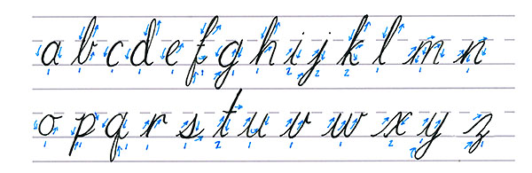
English
English is taught through a novel study approach. Our year group has 5 novels/picture books and 1 non-fiction unit which links with our topics. Lessons follow the course of the book and produce lots of learning opportunities.
Children work against a list of ‘Non-Negotiables’ to help them with their writing. If children include the ‘Non-Negotiables’ in their writing across the year in a variety of texts, then they will achieve age-related expectations at the end of the year. The ‘Non-Negotiables’ are on display in classrooms, stuck in their English books and laminated copies are on the tables to support their learning.
Cursive handwriting is taught across the school.
Handwriting is taught every day during English lessons.

Slide 5

Reading
Children should be reading for 20 minutes each evening to help continue their progress. Each year group has a different length of time, which you can find in the appendix to our Reading Policy on the next slide.
All children will be given a reading journal at the start of the year to record their reading practice. This should be used daily.
Children will earn ‘All Start Reading Hero’ points every time they read and bring their journals back to school. These points are logged on Class Dojo and can be traded for prizes throughout the year.
The library will be reopened as soon as possible, with our volunteer librarians returning to A.R.H. this year. All classes will visit the library once a week.
If you have any further questions about English at Alderman Richard Hallam, please do not hesitate to contact our English Leads, Miss Underwood and Mrs Heaney-Fitzgerald.

Slide 6
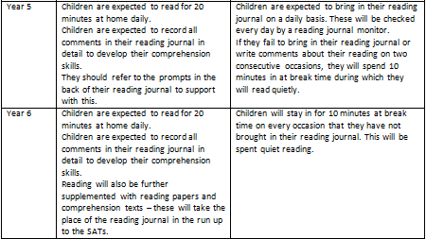
Home Reading Expectations
Notes:
Copy and paste for your year group from Reading Policy

Slide 7

Mathematics
At our school, Mathematics is taught as a whole class in mixed abilities.
Our lessons will be taught with a Mastery approach which ensure that all children in class are working in the same direction trying to achieve the same objective.
Through highly effective teaching, our children will be taught a range of skills in lessons which will promote making links, problem solving and reasoning.
If you would like to help your child at home, please use our calculation policy, which provides examples of how to support your child as well as resources we shall be using.
The Mathematics team organise three maths weeks a year so keep a look out for these!
If you have any further questions about Mathematics at A.R.H, please do not hesitate to contact our Maths Leads, Mrs Barnes and Mrs Cunningham.

Slide 8
Learning Feedback
We use whole class feedback to let our learners know how they are doing. This is a technique that replaces standard written feedback in books and allows teachers to be more responsive to the needs of their class. The focus is on effective verbal feedback that ensures children receive direct support on the same day as the lesson or as soon as possible. Teachers respond to the lesson and work produced to adapt future lessons and direct support as needed. This is recorded on feedback sheets rather than in books.
You will find limited written feedback in books due to this. The class will receive high quality feedback, praise and support in a much more responsive and timely way.

Slide 9
Homework
Homework activities should be accessible for all children and will be tailored where appropriate to meet a child’s individual needs, including any special educational needs. Children are encouraged to spend an appropriate amount of time on their learning outside of school.
Year 6
Twenty minutes or more a day reading with a weekly reading activity to complete
Vocabulary board meanings and spellings to be practised regularly
Maths. and English homework
Notes:
Delete other year group information and enlarge text.

Slide 10
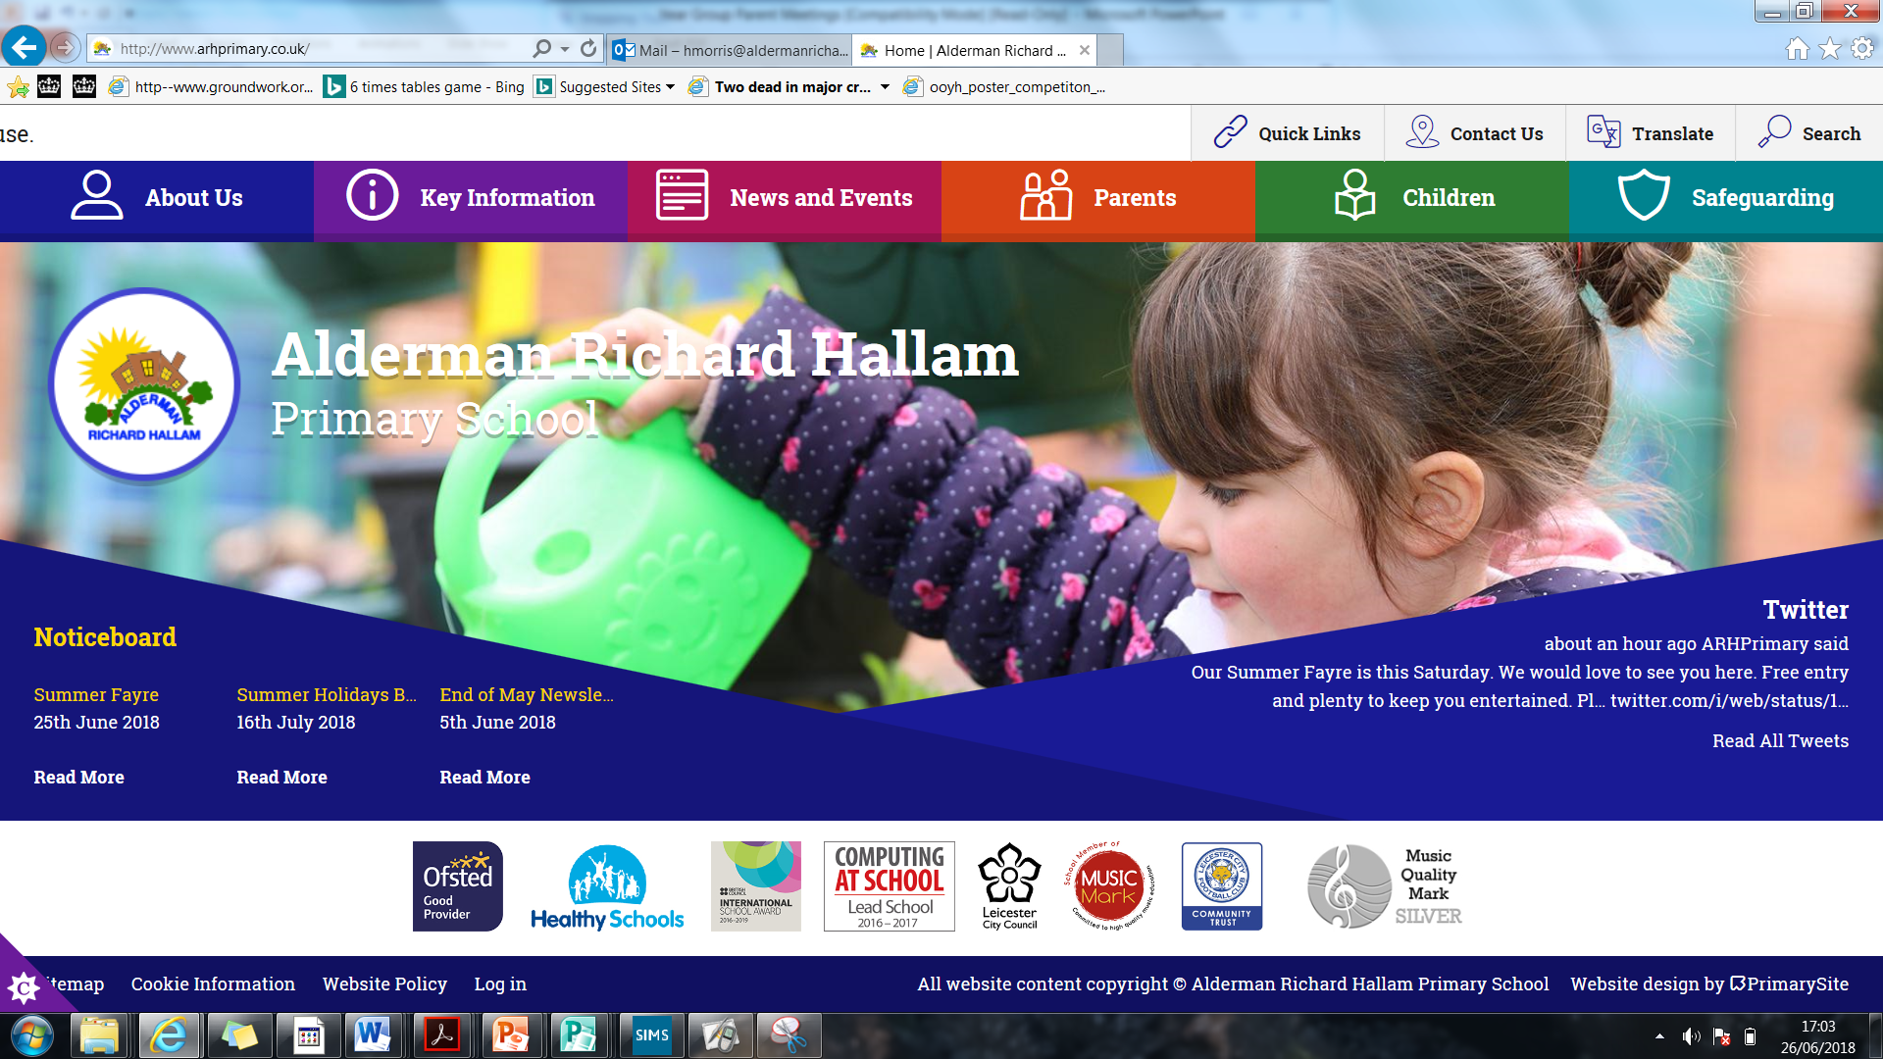
School Website
Our website has all the information, photos and letters that you need as well as contact information. It also contains a copy of this PowerPoint for you to refer to. Make sure you have a look through our website for answers to any questions you may have before contacting the school office.

Slide 11
Parent, Carer and Pupil Voice
At A.R.H, we give children lots of opportunities to share their ideas, opinions and suggestions. Children give their views for each of their topics so we are continuously adapting our way of teaching.
Our children also have ownership over electing the School Council who contribute to decision-making across the school, such as interviewing new teachers and sharing ideas for our fundraising events.
We will be inviting parents and carers to share views through twice annual questionnaires. Your voice is important to us so please respond and let us know how we’re doing!

Slide 12
Parent Conduct
At A.R.H, we want to build positive working relationships with all of our parents and carers to get the best possible outcomes for our pupils.
We have a Parent and Carer Code of Conduct which sets out our expectations both on site and online with regard to the school. We do not tolerate any form of aggressive behaviour towards our staff.
You can find our Code of Conduct on the school website. Feel free to speak to any member of SLT if you have any queries regarding this.
Notes:
This slide should be delivered by the phase lead.

Slide 13

Attendance
If your child is not going to be in school, please report the absence to us before 9:00am in one of the following way:
Call: 0116 262 4003 and select option 1 to leave a message
Email: absence1@aldermanrichardhallam.leicester.sch.uk
Online: via the Arbor Parent Portal
You must do this on each day of the absence unless you have notified us that your child will be absent for a period of time.
Notes:
Good Attendance Awards
Certificates are awarded termly for pupils with 100% attendance. Prizes are given annually for pupils with 100% attendance for the whole year. The attendance cup and certificate are presented weekly to the class in school with the highest attendance rate. All of the above are presented in assemblies so that good attendance continually receives a high profile. Exceptionally high attendance is also recognised at the annual leavers’ service for Year 6 pupils.

Slide 14
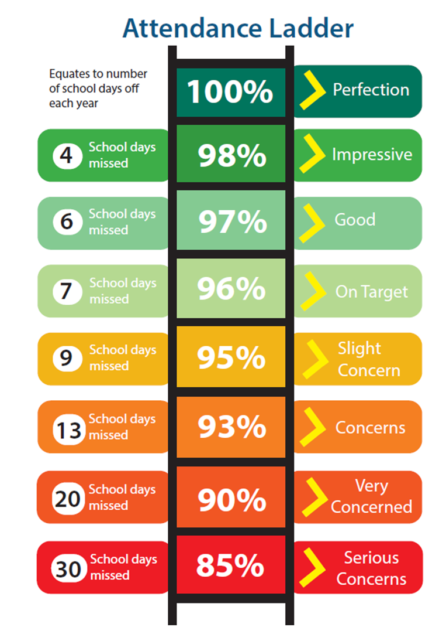
Attendance
If you have any questions about attendance, please contact Kirsty Johnson, our Attendance, Admission and Welfare Officer.
Telephone: 0116 262 4003
Email:
kjohnson3@aldermanrichardhallam.leicester.sch.uk
Notes:
Term Time Leave of Absence
Leave taken during term time will be unauthorised unless it is an exceptional circumstance. Penalty Notices may be issued where there are, 4 or more days unauthorised leave of absence. Therefore if your child has an unauthorised leave of absence, you may either be issued with a penalty notice of £120 per parent per child (discounted to £60 if paid within 21 days), or you could be referred by the Local Authority directly to the Magistrates’ Court.

Slide 15
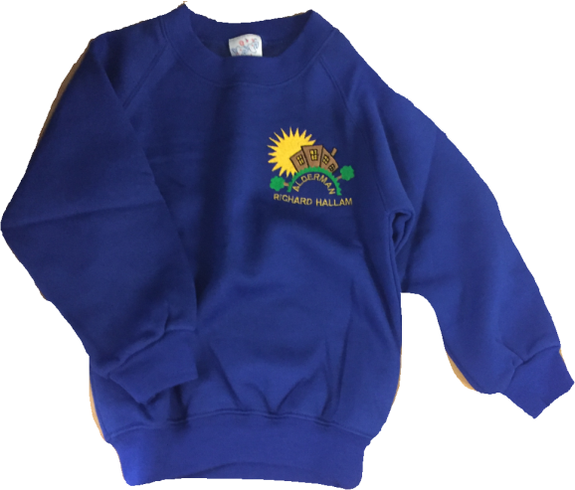

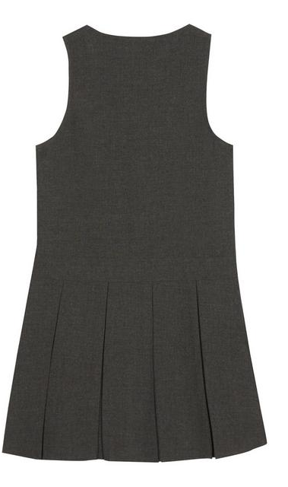
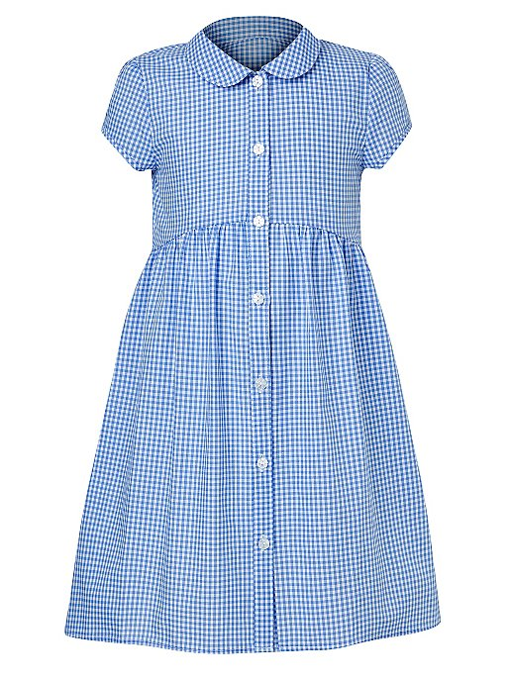
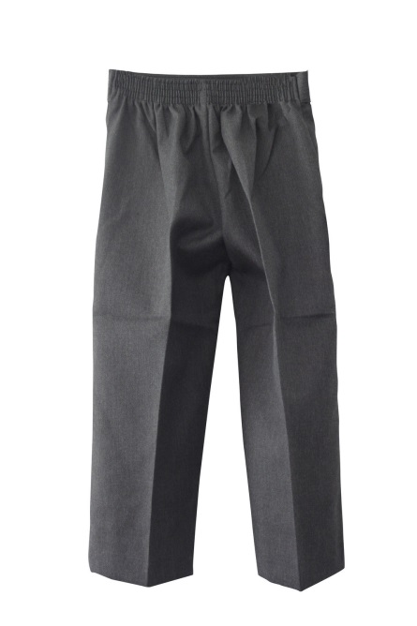

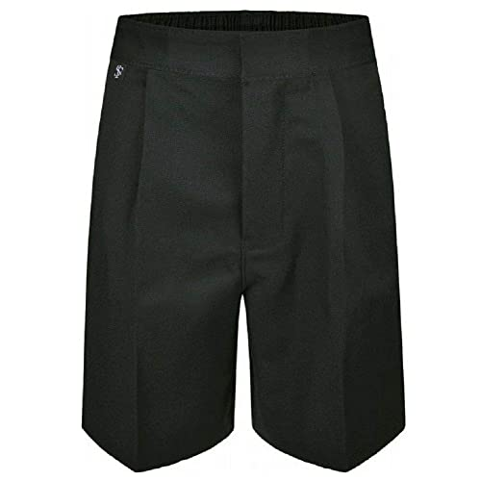
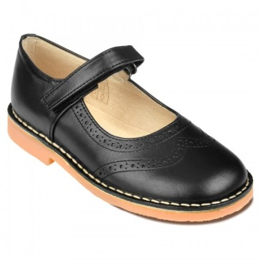
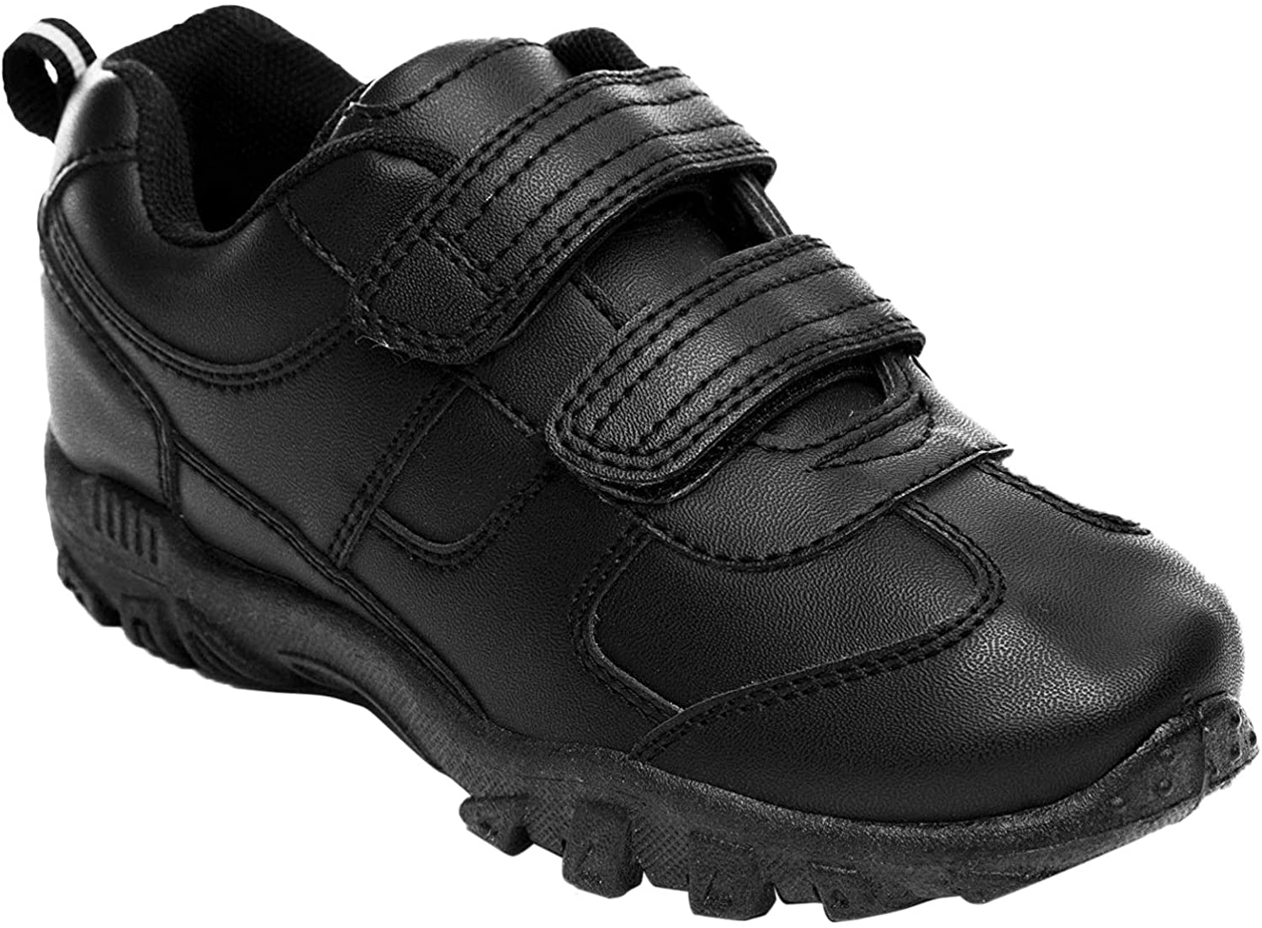
School Uniform
Our colours are royal blue, grey, black and white and the uniform is as follows:
School royal blue sweatshirt with school logo or other plain, royal blue sweatshirt
School royal blue cardigan with school logo or other plain, royal blue cardigan
Plain pale blue or white polo shirt, blouse or cotton shirt
Grey or black trousers, shorts or skirt
Grey pinafore dress
Blue gingham dresses
School royal blue book bag with school logo
Blue, white or black headgear

Slide 16


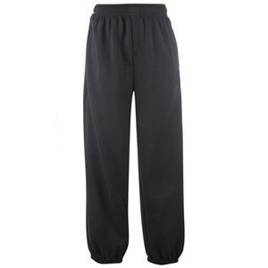
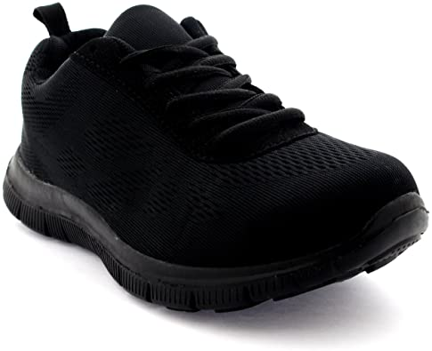
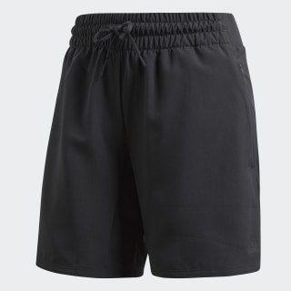
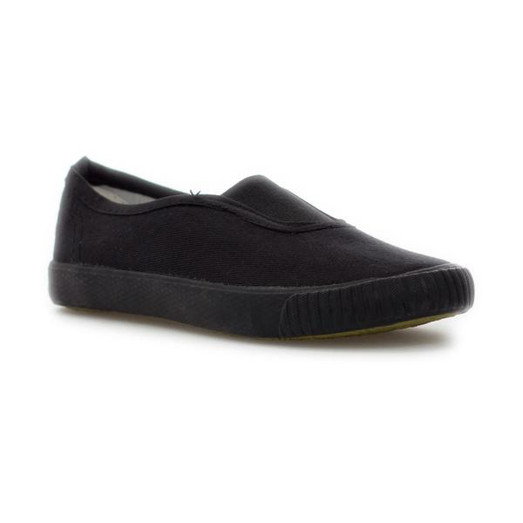
School Uniform – P.E. Kit
Outdoor P.E. kit:
White T-shirt
Black shorts or black jogging bottoms
Black, white or grey hoodie or jumper
A pair of trainers
Indoor P.E. kit:
White T-shirt
Black shorts
Plimsolls
Earrings are not allowed for P.E. lessons. Please see our Jewellery Policy for more details.

Slide 17
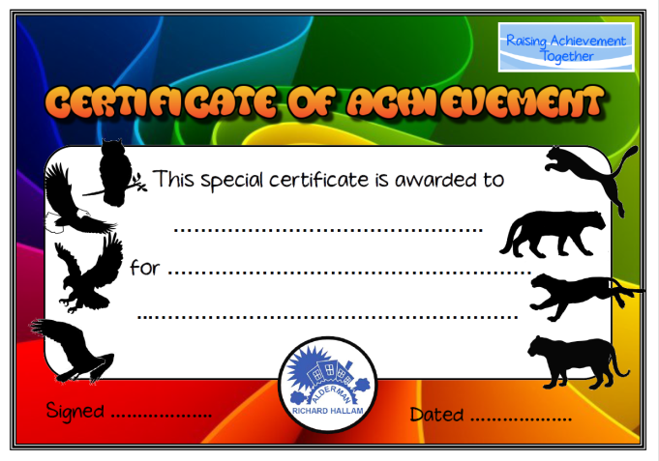


Behaviour
The golden rules:
If you would like to know more about our Behaviour Policy, you can find a copy here.
Be kind and gentle – don’t hurt others
Be honest – don’t tell lies
Try hard with your learning – don’t waste time in school
Listen carefully – don’t talk when others are speaking

Slide 18
IFS
IFS – Ingredients For Success
Student spotlight – we have a focus IFS each week which is celebrated on our weekly newsletter.
IFS are used in all lessons
All of us have these skills – sometimes we need to exercise them to develop them further
Why not ask your child which of the IFS are their strongest and which ones they are working on?
Empathy | Listening | Leadership | Teamwork | Judgement | Independence | Humour | Creativity | Fairness | Caring
Honesty | Curiosity | Resilience | Love of learning | Self-control | Enthusiasm | Bravery | Articulation | Reasoning | Focus

Slide 19



Mental Health
Ensuring our children, their families and our staff have good mental health is one of our highest priorities as a school.
We hold the Carnegie Centre of Excellence Mental Health GOLD Award.
To find out more about what we are doing, please look at our website.
If ever you, or your child, needs support in this area, please speak to your child’s class teacher or Mrs Afflick-Goodall, our Wellbeing Lead.

Slide 20

Anti-Bullying
At A.R.H, we take bullying very seriously and have a strong approach to any incidences of bullying.
We have a team of Anti-Bullying Champions. The Anti-Bullying Champions are clearly visible on the playground in their high-vis jackets. They have regular training on how to deal with a range of issues that may occur on the playground.
Please look at our Anti-Bullying section on the website. This has wonderful videos and activities you can share with your child as well as our child-friendly anti-bullying policy.
We currently hold Leicester City’s ‘Positive and Peaceful Places’ accreditation.
If you ever have a concern about bullying, please speak to your child’s class teacher or report on our school website.

Slide 21
No Outsiders in our School
We want to make sure that no one feels like an outsider at A.R.H. The ‘No outsiders’ scheme is the strategy our school uses to ensure all children understand the protected characteristics outlined in the Equality Act 2010.
These books provide support in the delivery of the objectives outlined in the Equality Act 2010; and in the provision of personal, social, health and economic education (PSHE) for every child. The books promote equality for all sections of the community. But more than that, the resources aim to bring children and parents on board from the start so that children leave primary school happy and excited about living in a community full of difference and diversity, whether that difference is through ethnicity, gender, ability, sexual orientation, gender identity, age or religion.
All books are available to look through at the end of the meeting. If you have any questions regarding them, please speak to your class teacher or contact Mrs Pickering cpickering@aldermanrichardhallam.leicester.sch.uk.
Notes:
Make sure your year group’s no outsiders books are available for parents to look through after the meeting

Slide 22


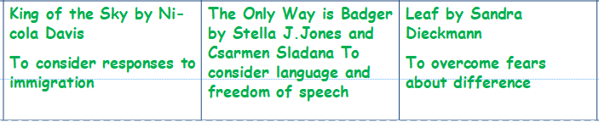





No Outsiders in our School
Notes:
Please include some pictures of your year group’s no outsiders books

Slide 23
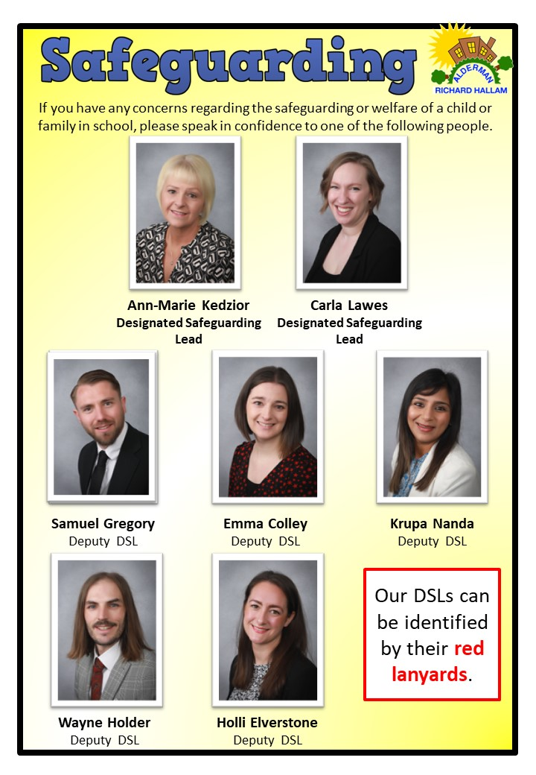
Safeguarding
Our school has very robust safeguarding procedures in place. If a concern is raised, teachers and teaching assistants will usually speak to you in the first instance. We want to ensure that all children at A.R.H. are happy and safe at all times.
If you ever want to raise a concern with us, please
speak to a member of our safeguarding team.
Operation Encompass – this is an initiative in Leicester
City. If a child has been witness to an incident or
involved with criminal activity, the school will be
informed so that we can ensure the child is supported
at school.
We teach the children how to keep themselves safe
through lessons and assemblies. You can find out
more about this here.

Slide 24
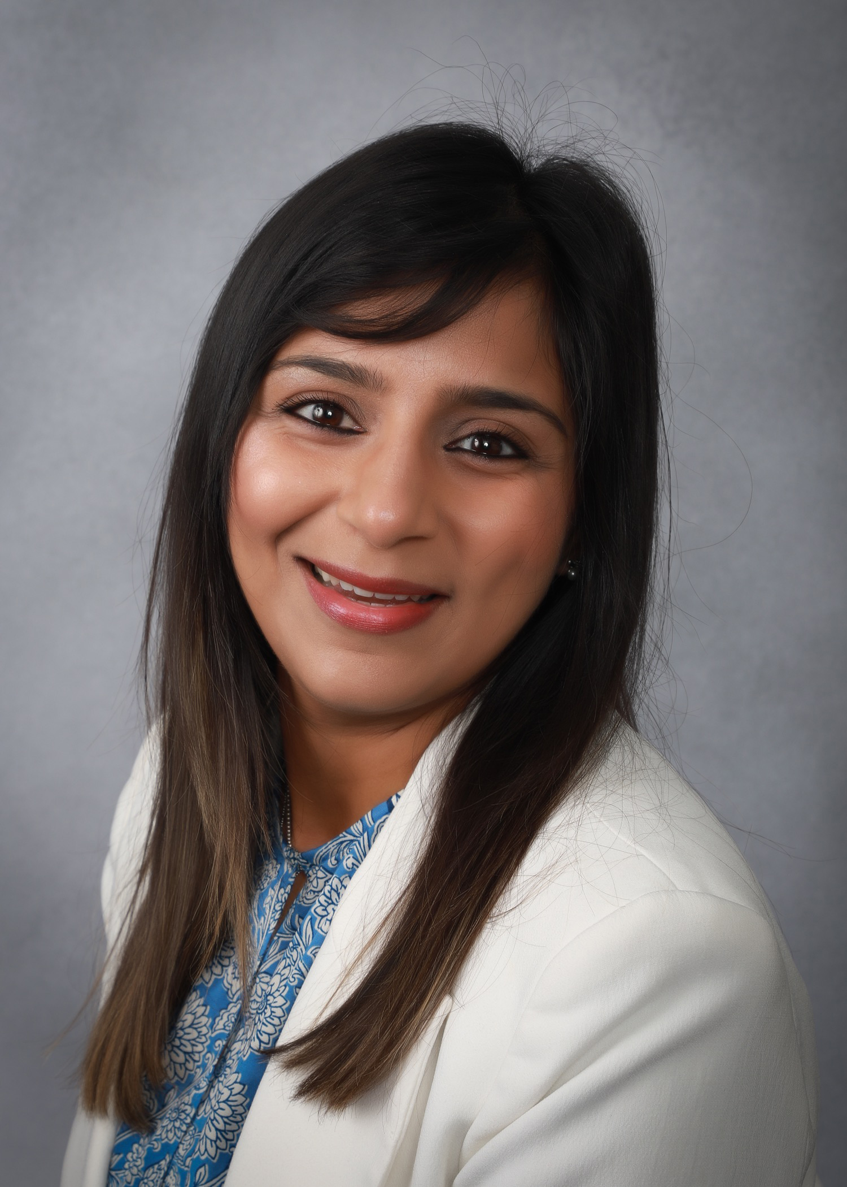
Special Educational Needs and/or Disabilities (SEND)
Our SEND Coordinator is Mrs Nanda.
Her contact details can be found on the school website.
If you have any concerns or enquiries in this area, then feel free to speak to the class teacher in the first instance.
Mrs Nanda will be hosting SEND Coffee Mornings throughout the year. Please check the Latest News for the dates as some are combined with training for parents and carers.
You can find more information on our website.

Slide 25
School Nurse and Early Help
If you require extra support, you can utilise the following services:
School nurse: 0300 300 3001
Early Help: 0116 454 1004
If you’re not sure who to contact but would like support, please don’t hesitate to talk to your child’s class teacher.

Slide 26
Free School Meals
You can apply easily for free school meals using our online form here.
If you are receiving certain benefits, FREE support is available for your children at ARH.
The benefits:
A free school meal for your child
Savings for you worth over £350 a year
Extra money for the school through Pupil Premium worth at least £1320 per year
Just registering your child for Free School Meals means that ARH receives the extra money even if you don’t take up the free meal. Applying will not affect any other benefits you are claiming.
There is no need for precious applicants to re-register.
Do you qualify? Your child may be eligible for Free School Meals if you get any of these benefits:
Income support
Income-based jobseeker’s allowance
Income-related employment and support allowance
Support under Part VI of the Immigration and Asylum Act 1999
The Guarantee element of State Pension Credit
Child Tax Credit, provided they are not entitled to Working Tax Credit and have an annual income (as assessed by HM Revenue & Customs) that does not exceed £16,190
Working Tax Credit ‘run on’ – the payment someone may receive for a further four weeks after they also stop qualifying for Working Tax Credit

Slide 27


Slide 28


Slide 29
Concerns or questions?
Stage | Role | Staff Member(s)
1 | Class Teacher | Mr Gregory, Mrs Colley, Mrs Bishop, Mr Imman and Mr Vaghela
2 | Year Group Leaders | Mr Gregory and Mrs Bishop
3 | Phase Leader | Mr Beardsmore
4 | Senior Leadership Team | Miss Kedzior (Headteacher) Mr Beardsmore (Deputy Headteacher) Mrs Lawes or Mrs Colley (Senior Assistant Headteachers) Mrs Nanda, Mrs Elverstone or Mr Gregory (Assistant Headteachers) Mr Holder (Business Manager)
Please ensure you speak to the relevant member of staff. Arrange an appointment to speak to them by booking an appointment through the school office on 0116 262 4003. They may not be available at the end of the day due to other meetings or school events so please let them or the office know you wish to speak to them and what it is regarding.

