Slide 1
PSHE and Citizenship
Health and Wellbeing | Looking After Your Wellbeing
PSHE and Citizenship | Age 9-11 | Home Learning | Health and Wellbeing | Looking After Your Wellbeing

Slide 3
Aim
I understand that there are strategies and behaviours that support my mental health and wellbeing.
Success Criteria
I can think of ways I can show self-kindness.
I can list the areas I can control and the areas I can’t control.
I can think of ways to connect with other people for support.
This resource is fully in line with the Learning Outcomes and Core Themes outlined in the PSHE Association’s Programme of Study.

Slide 4
The Big Questions

Slide 5


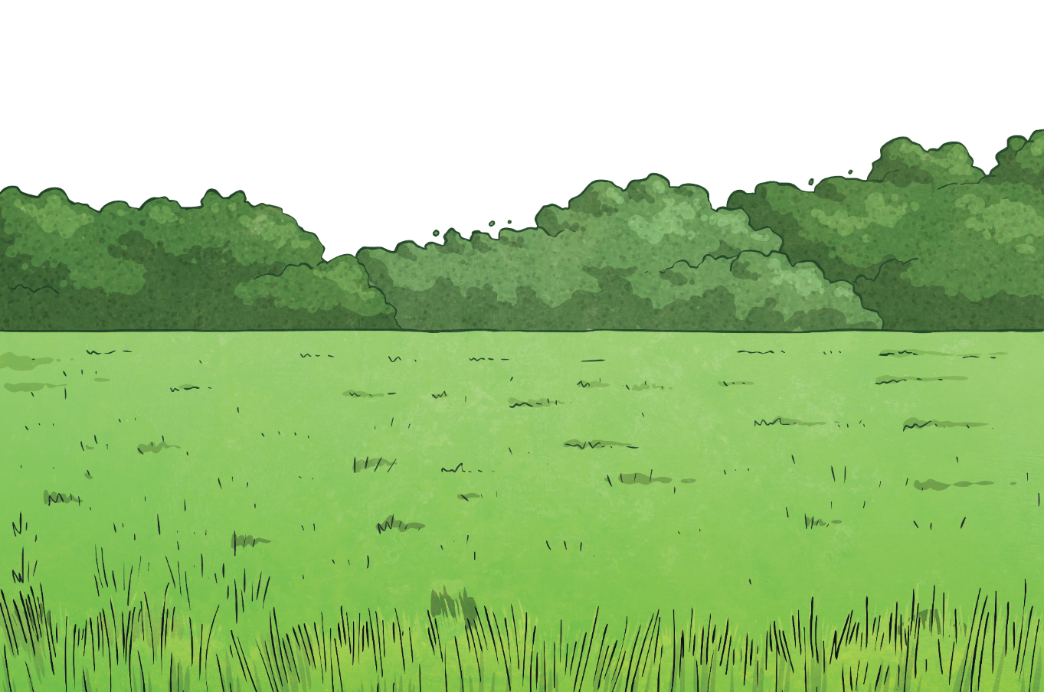
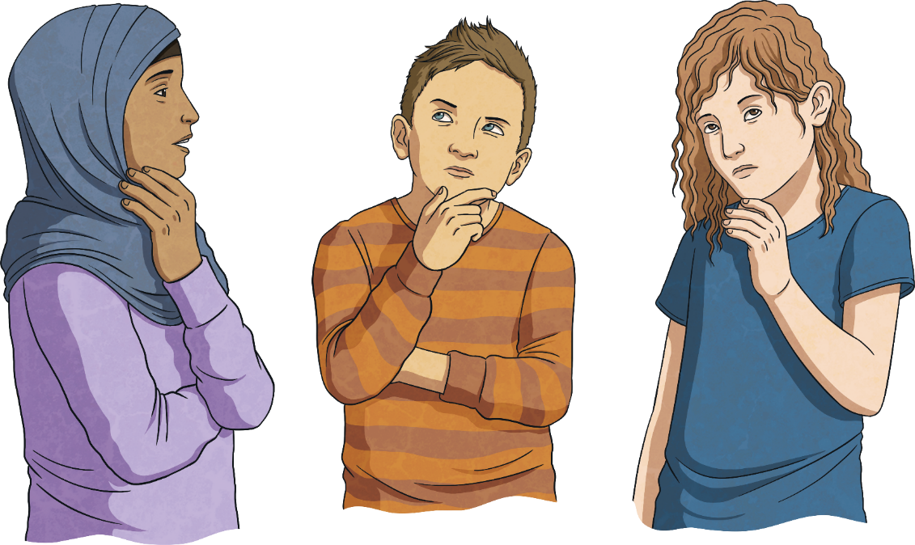
What is wellbeing?
How can I look after my own wellbeing?

Slide 6



What Is Wellbeing?
When you try to look after your own wellbeing, you think about:
how comfortable you are (both physically and mentally);
how healthy you are (both physically and mentally); and
how happy you are.
Wellbeing is explained as feeling…
comfortable,
healthy,
or happy.
If life changes, you may feel a lack of control, which can then make you feel unsettled. This can affect your wellbeing and how you feel. Changes can take you out of your comfort zone and make you see life a bit differently; all of which can be unsettling.

Slide 7
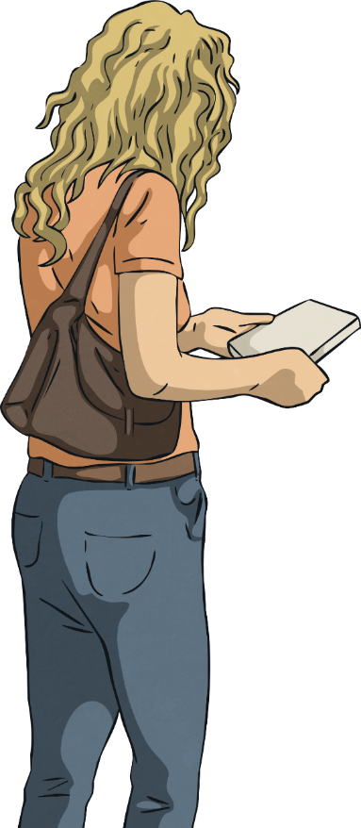
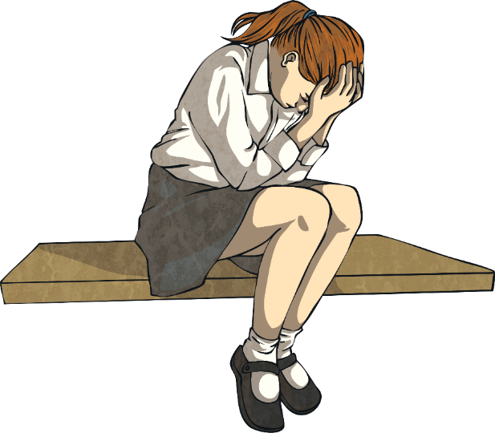
What Is Wellbeing?
When people feel anxious or worried about changes, they will try and control any areas of their life that they can.
This might not be the ‘right’ thing to do but it is often done by people trying to look after their wellbeing in the only way they know how.
When people are dealing with change, they often try and control the only things they can.
This might be what they buy from the shop or what their home looks like.
Today you will learn some other ways to look after your wellbeing, especially in a time of change.

Slide 8
Reconnecting

Slide 9
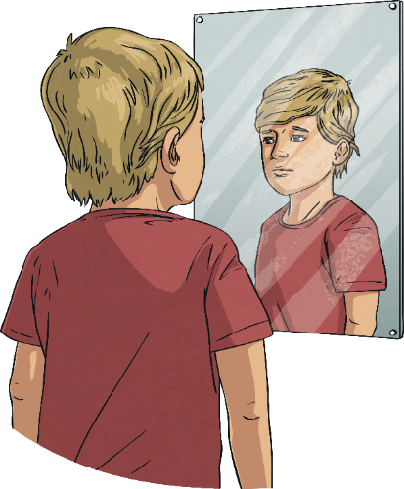
Be Kind
When change is happening in the world around you, or when things feel a bit more difficult, it is important to remember to be kind in your thoughts, words and actions.
This includes being kind to others but also being kind to yourself.

Slide 10
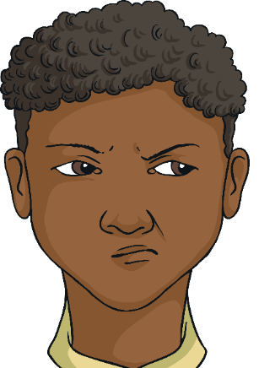
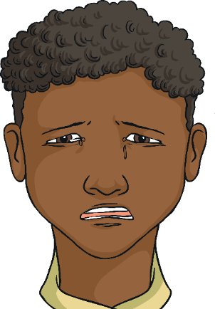

Be Kind
When deciding how to react and respond to other people, it is important to understand why they are behaving in a certain way, as well as their emotions or situation. This understanding can help you decide how to interpret their behaviour and words but also how to forgive and be kind, if necessary.
How could you show yourself some kindness?
It is also important to have the same patience and understanding
with yourself.

Slide 11
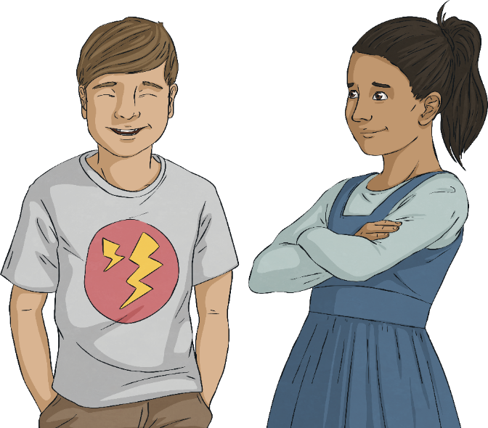
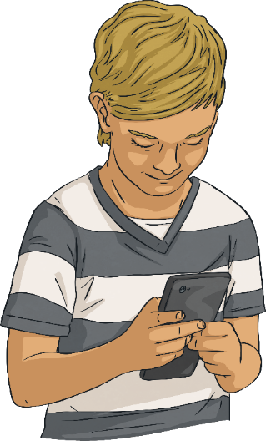
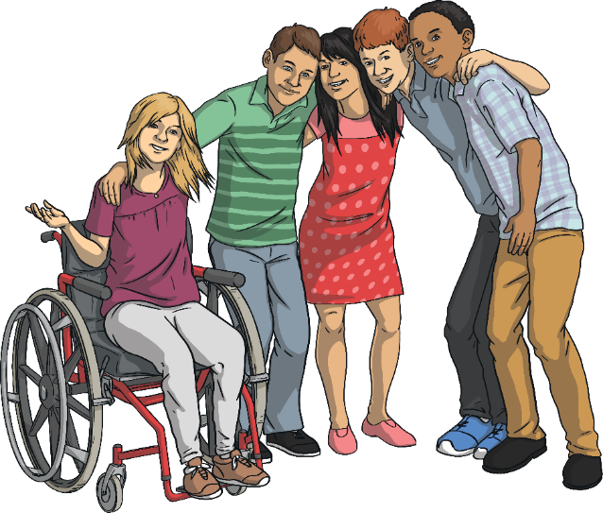
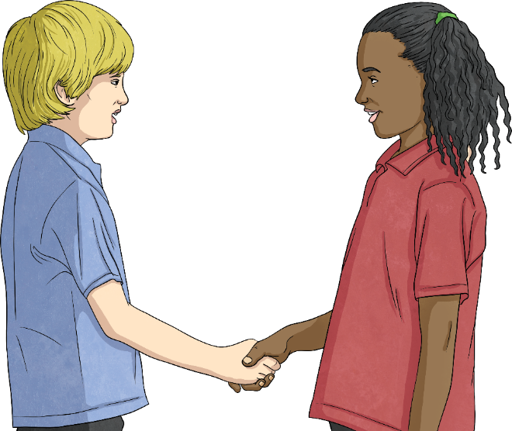
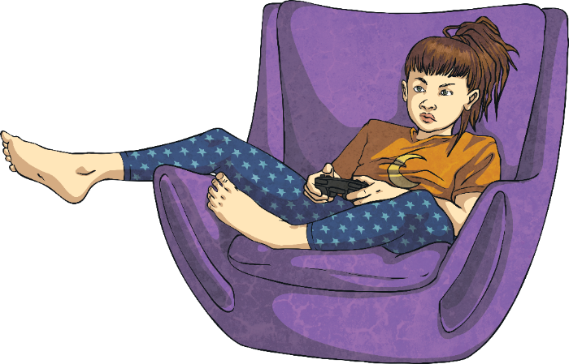
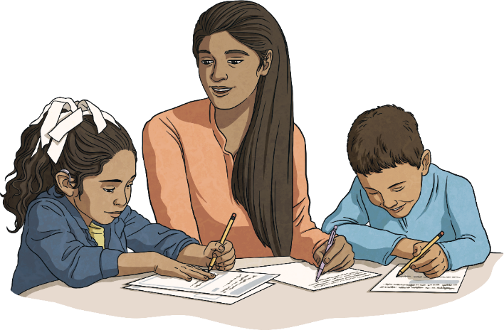
Connect with Others
Connections are a really important part of your wellbeing and for these to be strong, you need to put time and energy into creating and keeping these. It isn’t always easy but it is important for you to have others that look out for your wellbeing and support it.
An important part of wellbeing is being connected with other people. This is called a support network. You will be part of other people’s support networks, where you will support their wellbeing, and other people will be in your support network. This might include family, friends, teachers at school and members of the community.
If you are having difficulties with your wellbeing, it is really important to reach out and connect with someone in your support network.
This might be through face-to-face interactions or, if this is not possible or you’d prefer it a different way, it could be through letters, messaging, telephone calls, video calls or playing games together on the Internet (always check with your parents or carers first if you want to go online).
Who is in your support network?

Slide 12
Exploring

Slide 13
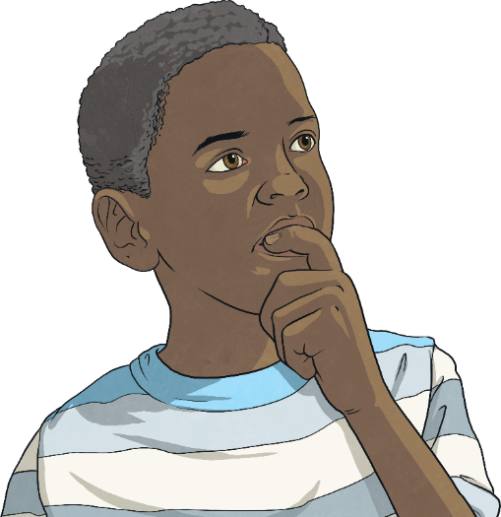
Positive Mindset
Part of coping with times of change or stress is ensuring that the way you see the situation is through a positive mindset.
This means looking for opportunities in every situation, no matter how challenging or difficult they are.
This approach can help you to:
see life in a different way;
organise or think about the priorities in your life;
value people over ‘things’;
remember what is important within your life;
recognise the value of your health and wellbeing; and
recognise the value of loving others and being loved.

Slide 14
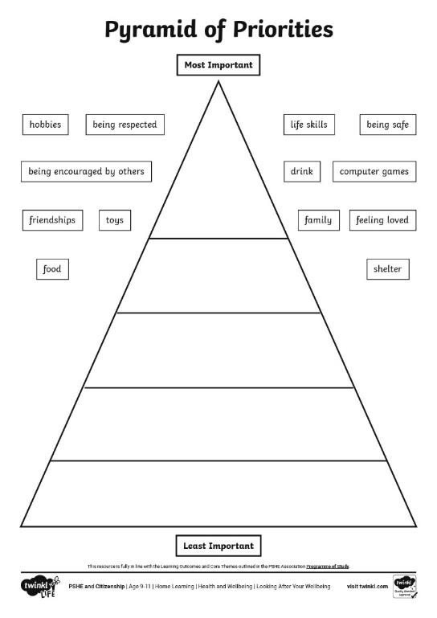
Positive Mindset
Look at the pyramid. Think about where you would put each of the different things in your own pyramid.
Discuss this with someone else in
your house and see if there are areas where you feel the same and areas where you differ.
Remember, all of the things within your triangle are important. This is about thinking which are more important to you than others. There is no ‘right’ or ‘wrong’ answers.

Slide 15
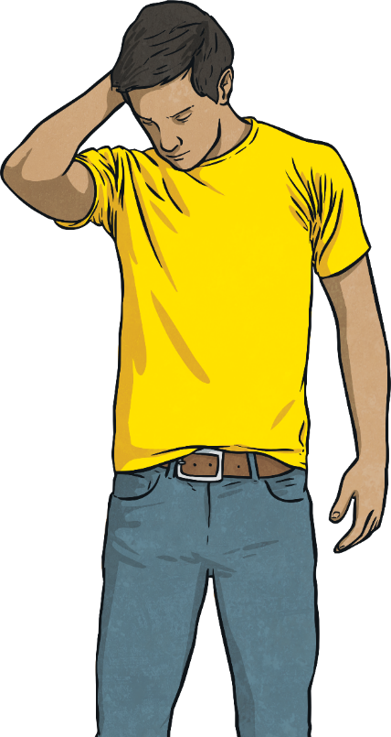
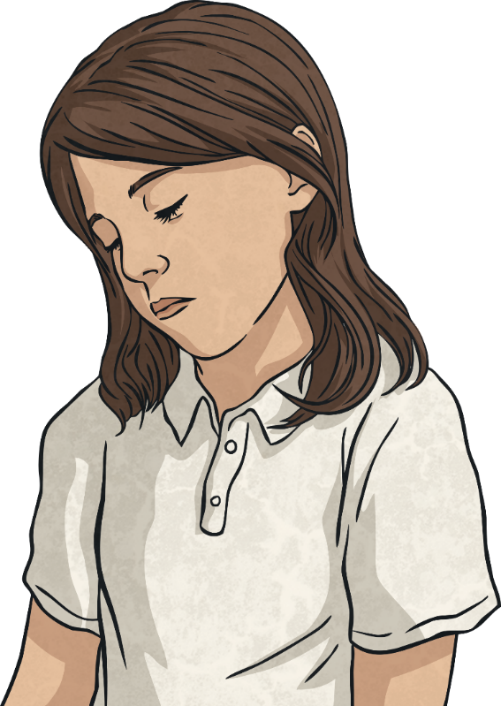
Areas of Control
It is important to break down your thoughts and worries into things you can actually control and areas where you have no control.
Lots of people spend time worrying about things that they actually have no control over.
Because they have no control, they can’t do anything to make it better so it can become a big area of worry. This can affect their wellbeing.
This can help you to realise what you should spend your time focusing on and putting energy into.
It also lets you think about the areas that you need to let go of, as you have no control over them.

Slide 16
Areas of Control
Things I Can Control
Things I Can’t Control
getting older
what other people think
traffic
who I play with
the weather
what other people do
my self-care
what I eat
what other people say
what I wear
my opinions
my thoughts
other people’s opinions
my words
what I say
what I do
what other people believe
my actions
how other people feel
Talk about where you would put each thing.

Slide 17
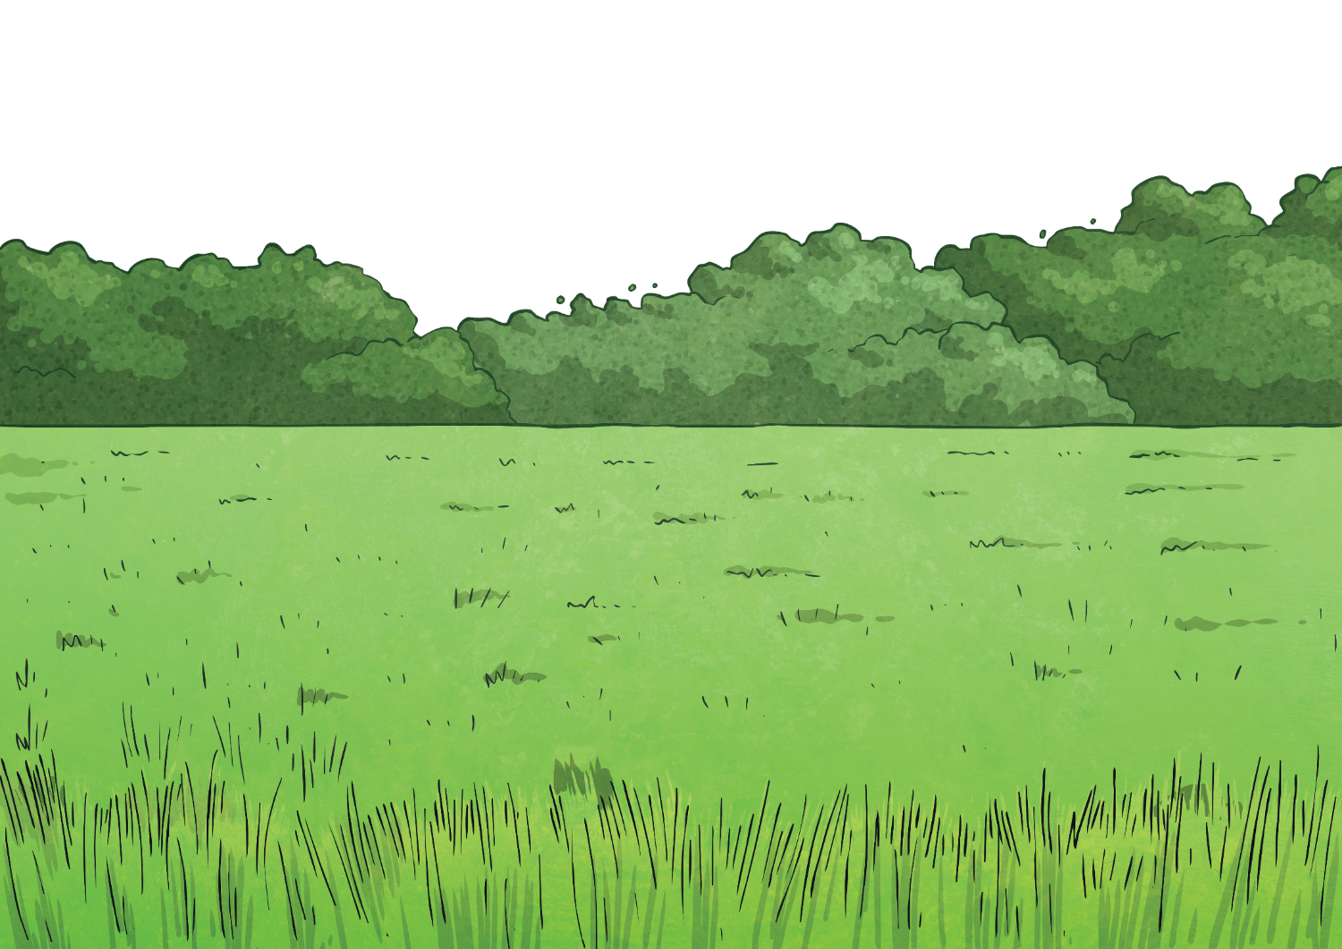

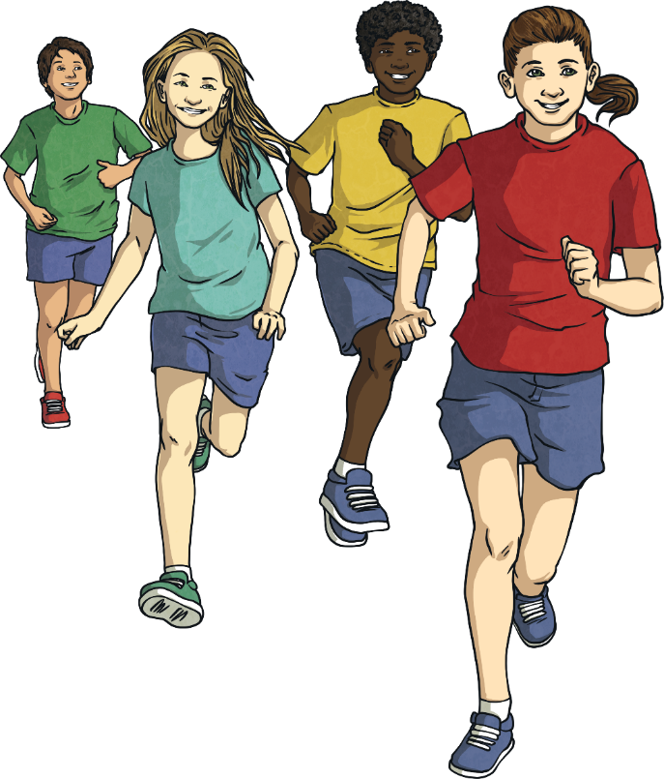
Consolidating
Reflecting

Slide 18
Consolidating

Slide 19
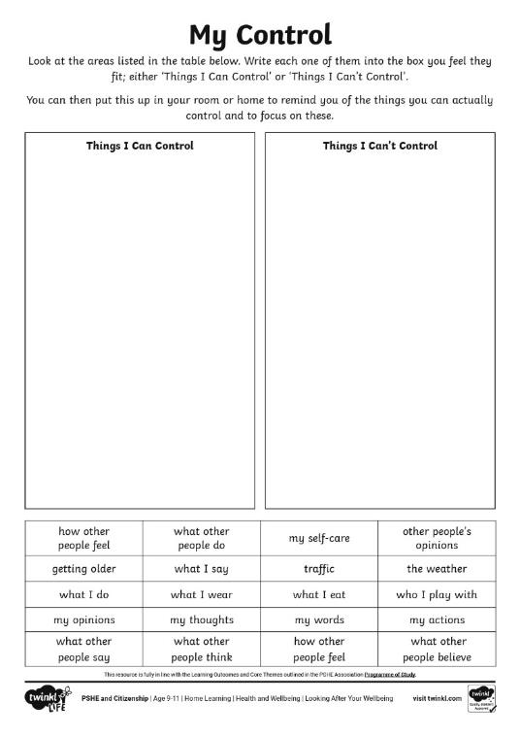
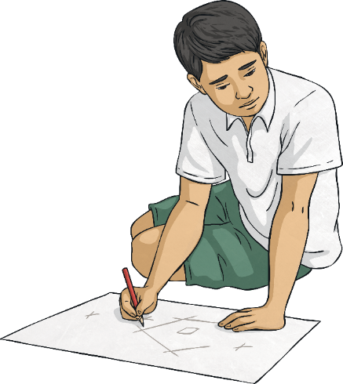
My Control
Using your My Control Activity Sheet, create a reminder of what you can and can’t control to display in your home.

Slide 20
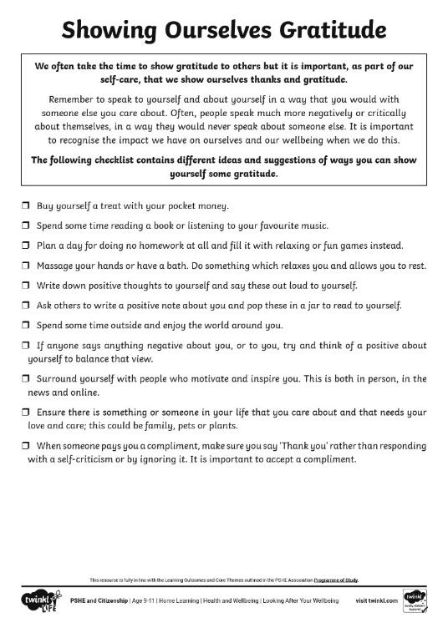
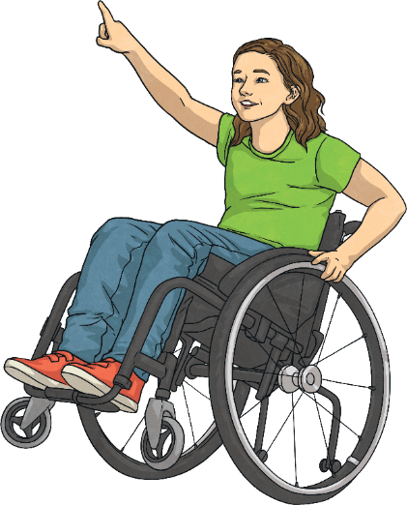
Self-Kindness
This Showing Ourselves Gratitude Activity Sheet can be used to help you think about ways you can be kind to yourself and show yourself some self-care.

Slide 21
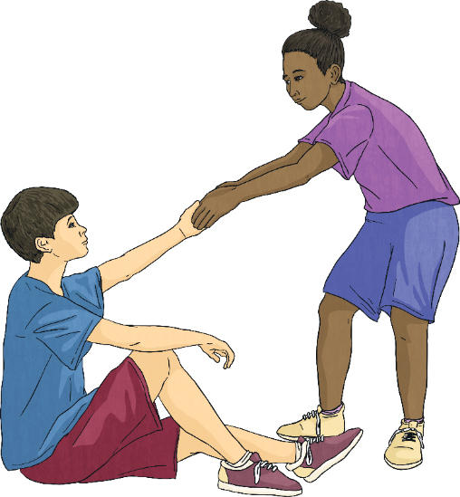
Support Networks
When you are looking after your own wellbeing, it is important to realise how much other people can help and support you.
As well as this, you can be there to support and help others. Often, focusing on other people can benefit your own wellbeing, as it helps you to feel good and positive.
Helping other people can make you feel needed and your support for them creates a support network for you when, or if, you need it.
It is important to reach out to others and say when you need help and support.
Remember, other people will feel good from helping you.

Slide 22
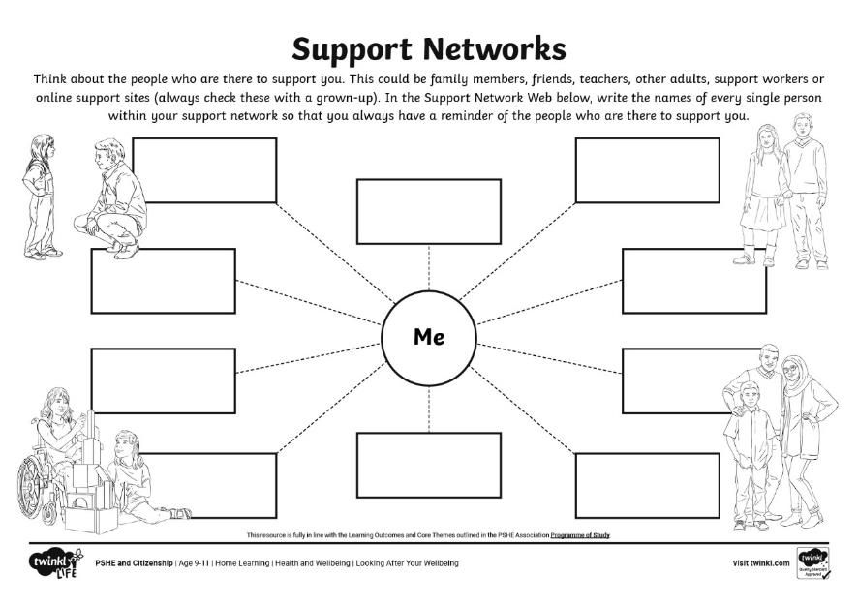
Support Networks
Use this Support Networks Activity Sheet to realise who is within your network of support.
Remember, you can go to anyone you feel comfortable talking to within your support network.

Slide 23
Reflecting

Slide 24

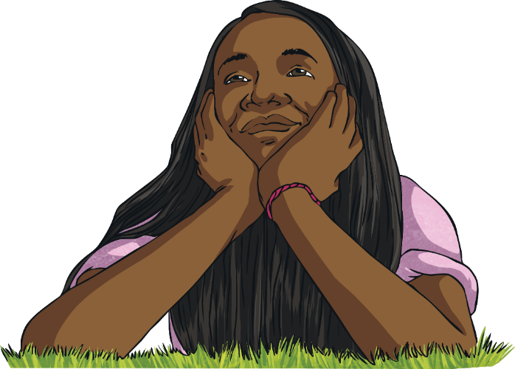
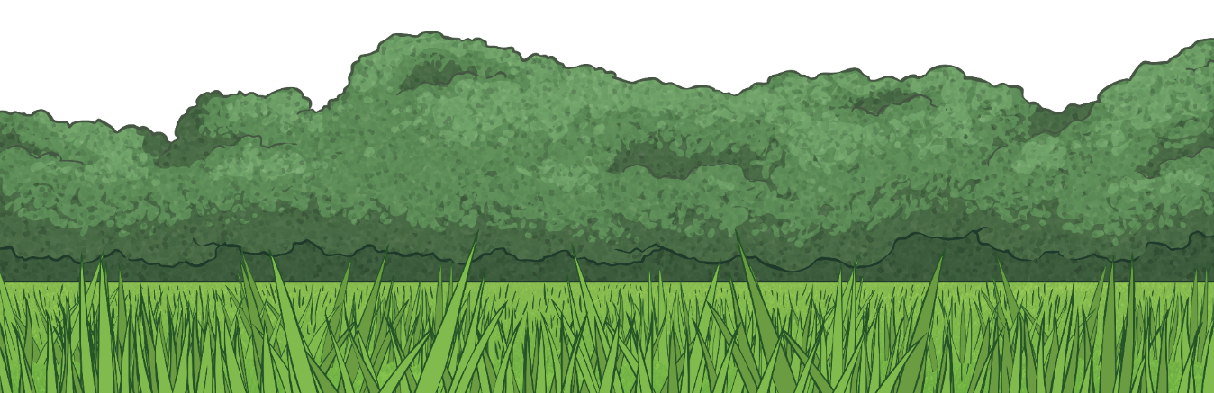
The Future
Think about:
How will life be different?
What will you do more of?
What will you do less of?
What will you worry about less?
How will you spend your time?
Whenever you are going through changes or a difficult situation, it can feel hard to see beyond the day or the situation you are living in.
While it can be sensible to think of life in this way, it can also be helpful to think about the future in a positive way as well.
Your future is ready and waiting for you!
These thoughts can help you to see the positive that can come from even the most difficult situations.

Slide 25
The Big Questions

Slide 26
What is wellbeing?
How can I look after my own wellbeing?

Slide 27
Aim
I can reflect on my learning.
Success Criteria
I can describe something I have learnt, and something I have learnt how to do.
I can explain how I can apply my learning.
I can set a goal for the future.

