Slide 1
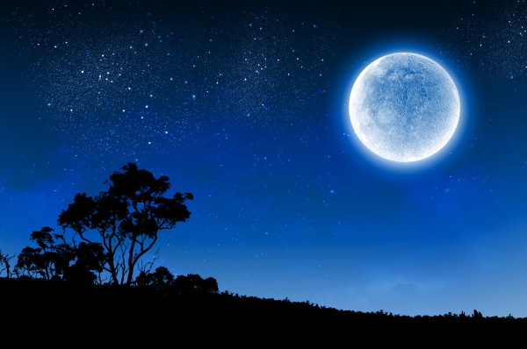
Moon Poetry

Slide 2

Read the following poems about the moon. What image do they generate in your head?

Slide 3
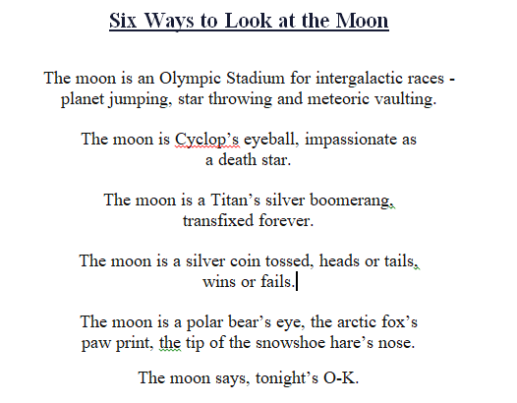
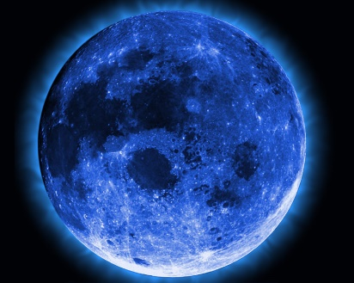

Slide 4

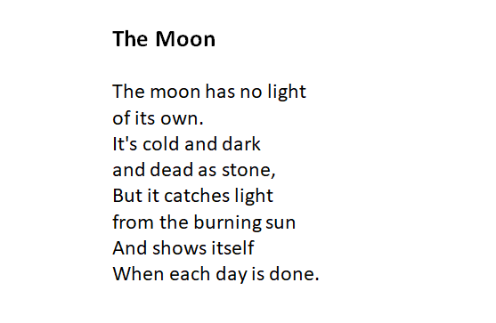


Slide 5
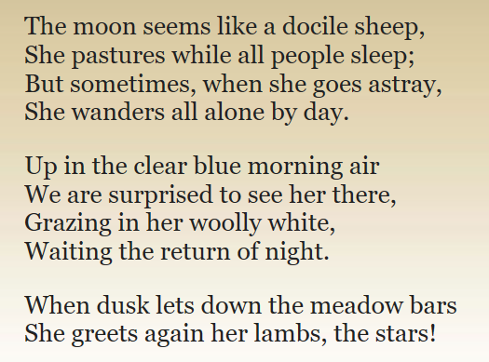

Slide 6
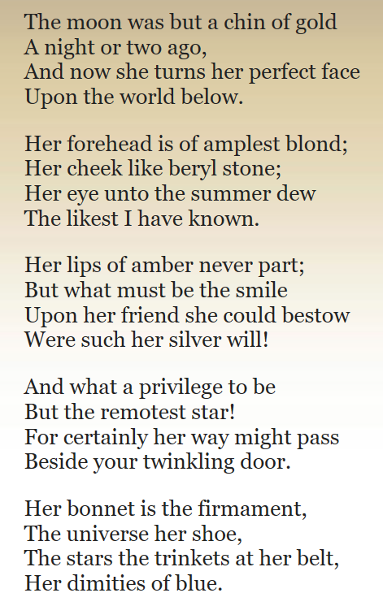
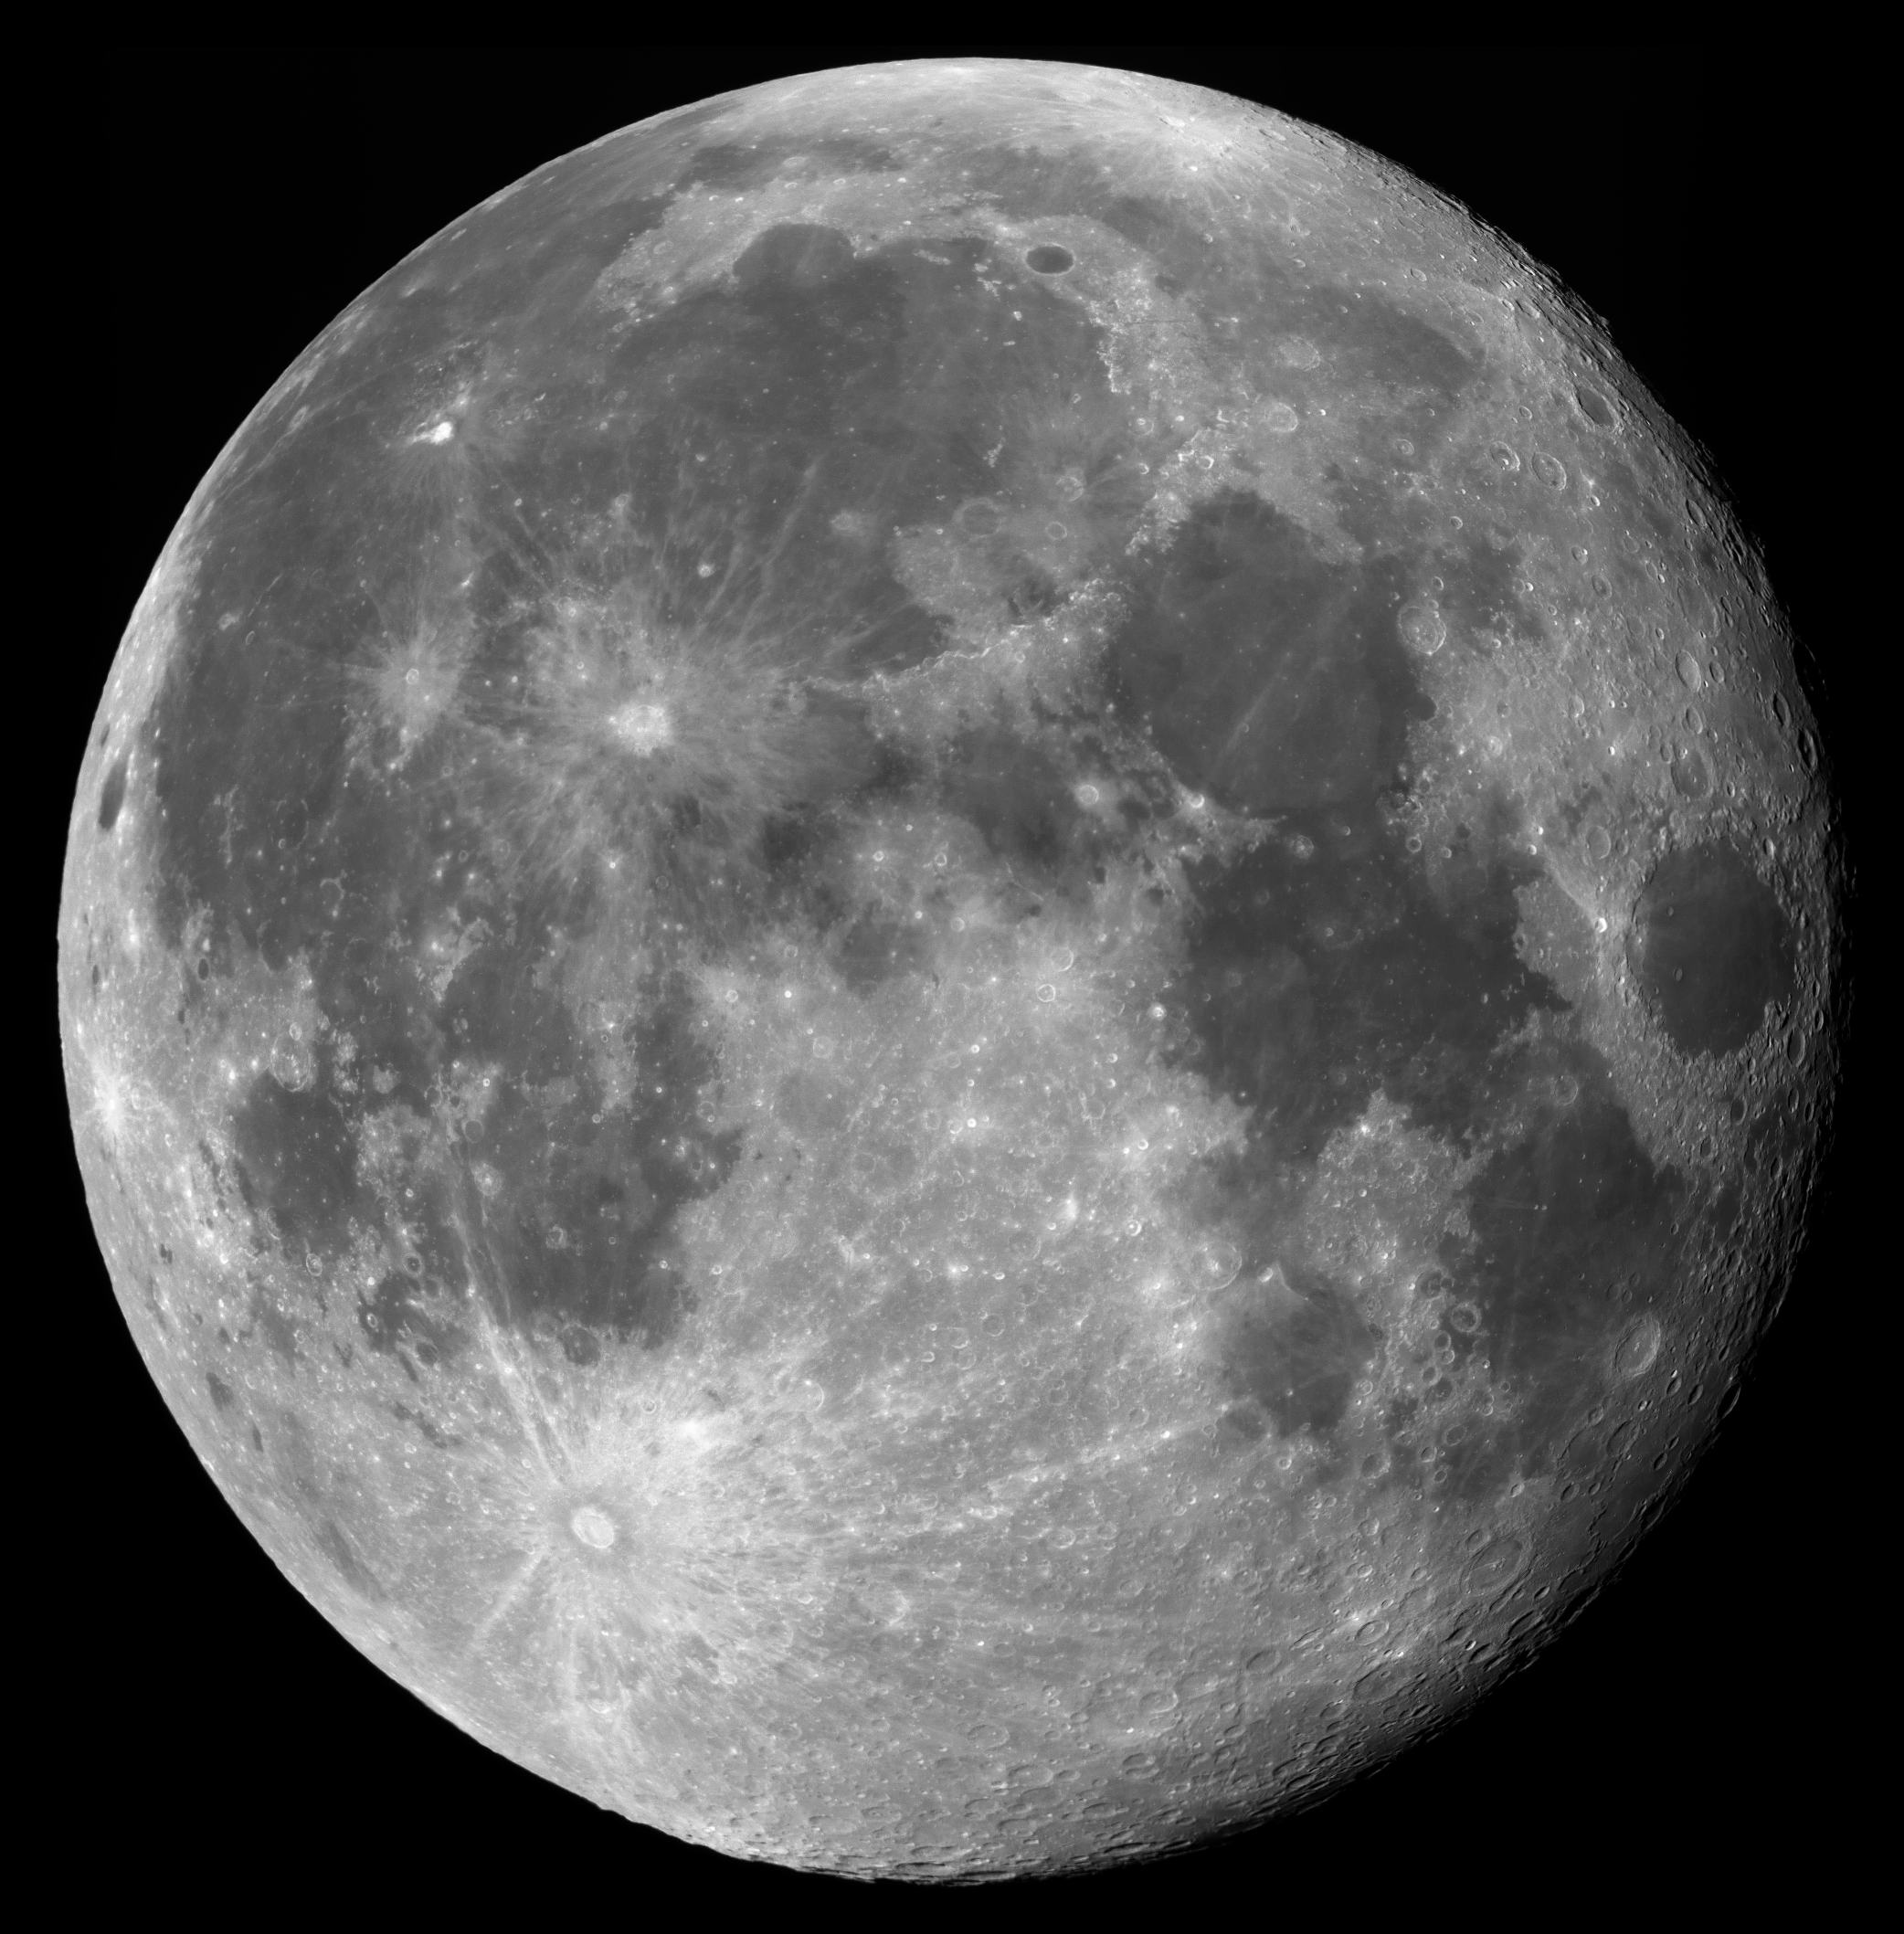

Slide 7
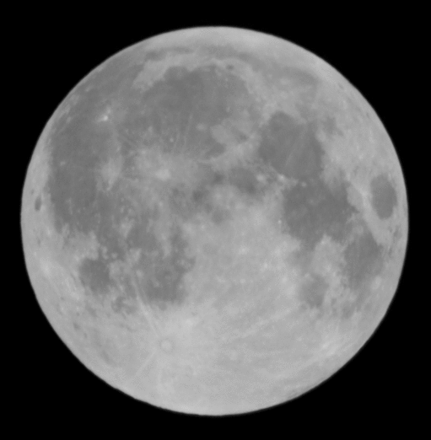
We would like you to draw/design your own picture of the moon. You could use chalk, tin foil, paints, collage materials. Use your imagination. Share your pictures on Twitter… Have fun!

