Slide 1
Learning Objectives
To practise our descriptive writing skills to create effective settings

Slide 2
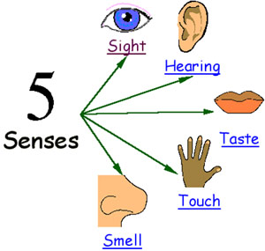
Setting
When you write about a setting, you need to make sure you use lots of description so a reader can picture themselves there.
Effective descriptions appeal to the senses.

Slide 3

One morning there was a different smell in the air, and the ship was moving oddly, with a brisker rocking from side to side instead of the plunging and soaring. Lyra was on deck a minute after she woke up, gazing greedily at the land: such a strange sight, after all that water, for though they had only been at sea a few days, Lyra felt as if they’d been on the ocean for months. Directly ahead of the ship a mountain rose, green-flanked and snow capped, and a little town and harbour lay below it: wooden houses with steep roofs, an oratory spire, cranes in the harbour, and clouds of gulls wheeling and crying. The smell was of fish, but mixed with it came land smells too: pine-resin and earth and something animal and musky, and something else that was cold and blank and wild: it might have been snow. It was the smell of the North.
SIGHT
HEARING
Seals frisked around the ship, showing their clown-faces above the water before sinking back without a splash. The wind that lifted spray off the white-capped waves was monstrously cold, and searched out every gap in Lyra’s wolfskin.
TOUCH
TASTE
SMELL

Slide 4
TASK: You are going to be shown a selection of different settings. For each image you see, you will be asked to write a description of the setting and include a specific language device.
See if you can experiment with appealing to different senses.

Slide 5
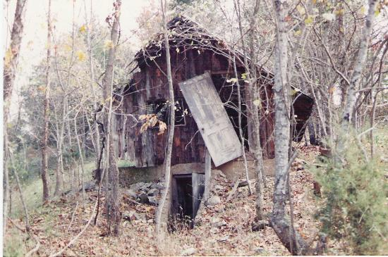

Vocabulary ideas: dilapidated, overgrown, wilderness, lonely, broken.
Describe this setting. You must include adjectives, verbs, adverbs, fronted adverbials and 5 senses!

Slide 6
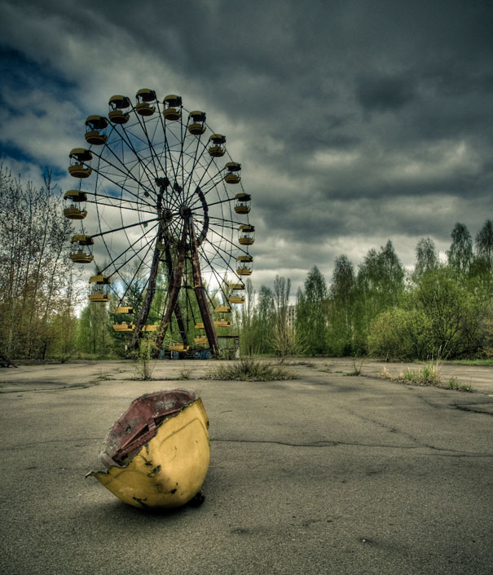

Vocabulary ideas: Menacing, abandoned, hostile, tragic, rotten
Describe this setting. You must include an example of personification (e.g. the clouds scowled)

Slide 7
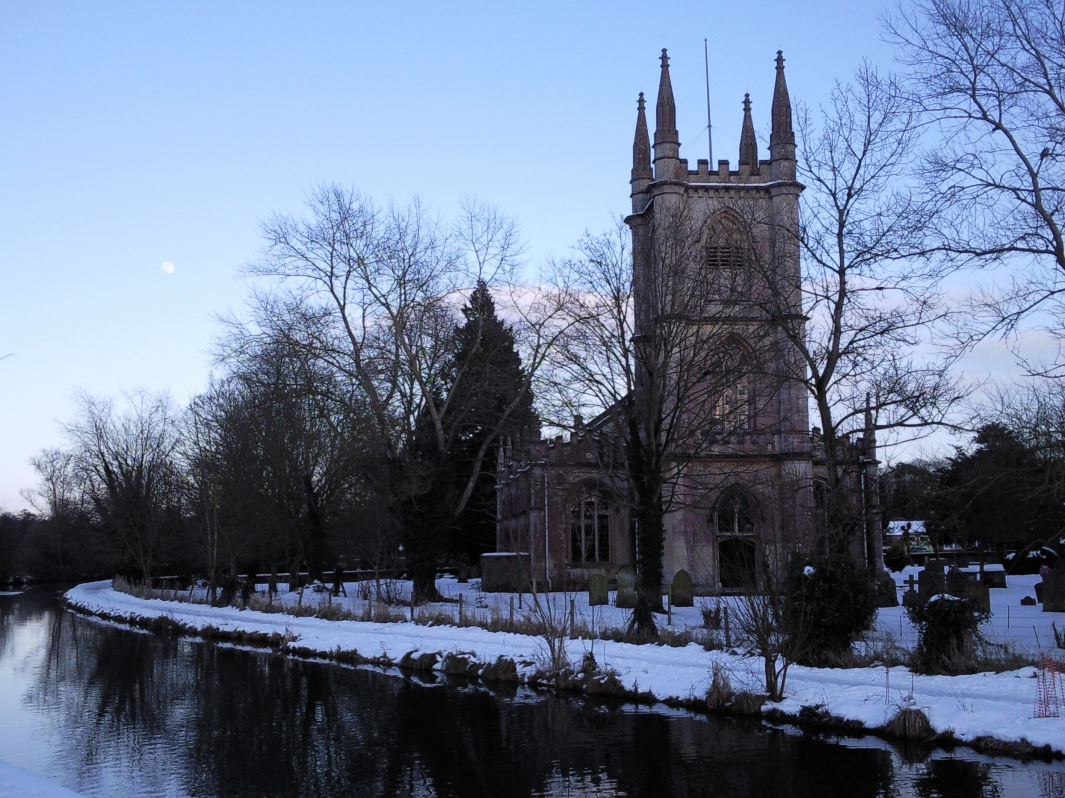

Vocabulary ideas: majestic, crisp, peaceful
Describe this setting. You must include a metaphor (saying something is something else e.g. the snow is soft velvet)

Slide 8
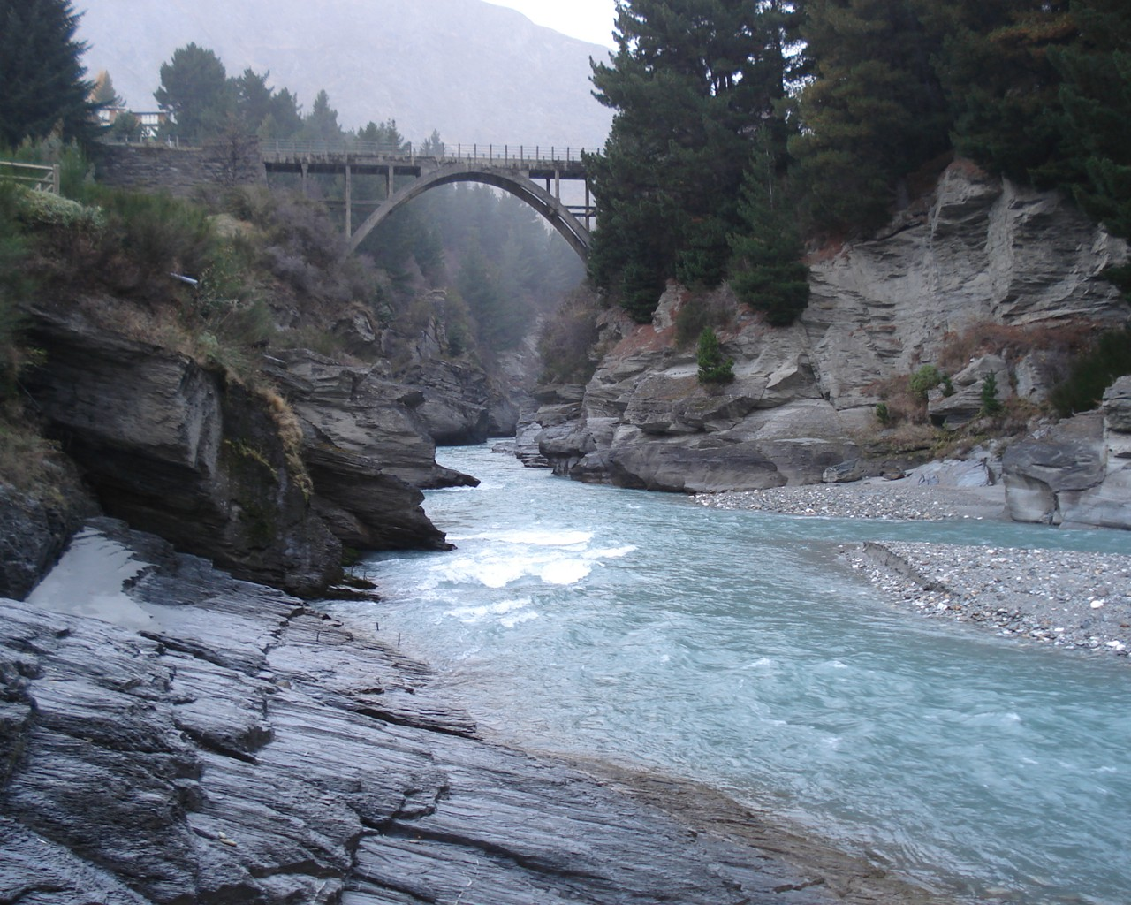

Vocabulary ideas: powerful, relentless, meanders , unforgiving
Describe this setting. You must include a simile (comparing two things using like or as e.g. The rocks jut out like...).

Slide 9

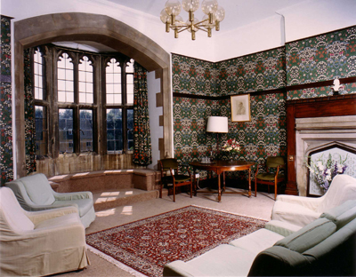
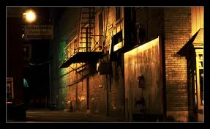
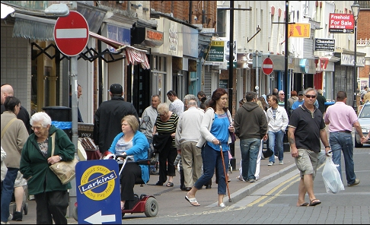
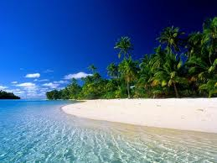
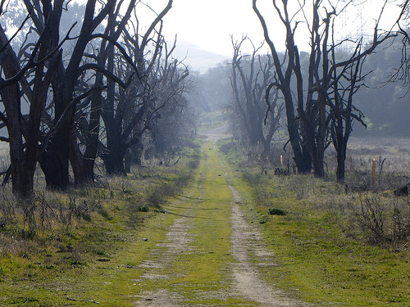
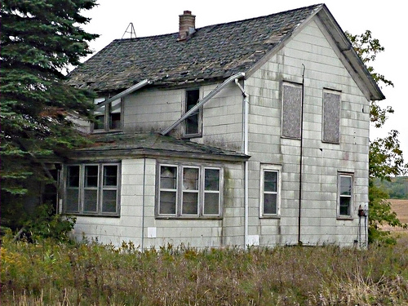
TASK: Pick a setting from the images below. Using the character you created yesterday, write a description of your character in this setting. Do they fit in comfortably or are they out of place?
You must include a simile
and a metaphor.
Verbs: How they enter? (do they shuffle, stride, skip etc.)
Adverbs: How they move? (confidently, cautiously, briskly etc.)
Similes: Could you compare them to an animal? What could you compare their eyes/hair/smile etc. to?
Metaphors: E.g. his hands were flat spiders; she had a heart of stone
What are their facial features like? (E.g. small, shifty eyes could indicate they’re secretive)
What are they wearing? Style of clothes and colours? (E.g. brightly coloured clothes = confident)
Remember to show NOT tell.

Slide 10
Self assessment
Read through your paragraph. Have you included:
Interesting verbs
Interesting adverbs
A simile
A metaphor
Which senses have you appealed to?

