Slide 1




Year 2 - Spring - Block 5
Length and Height

Slide 2
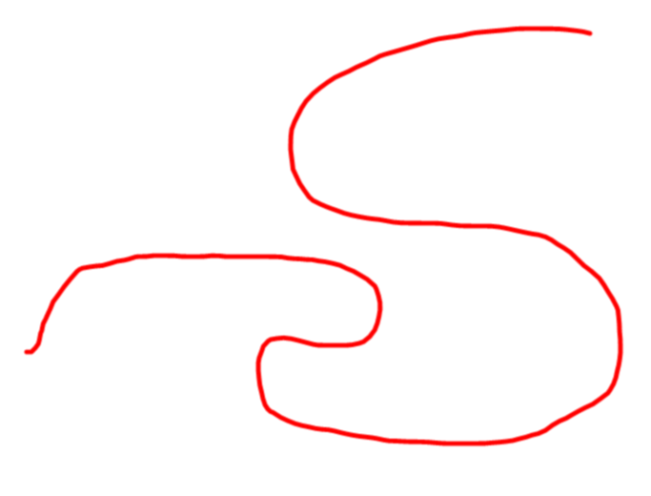
How long is this piece of string?
How could you find out?
Does the length change if you change the orientation?

Slide 3
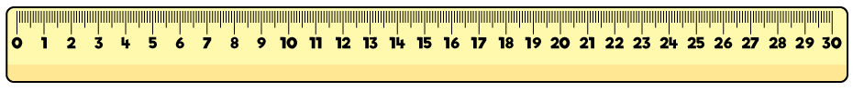
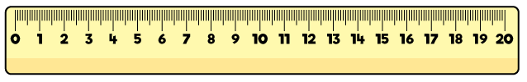

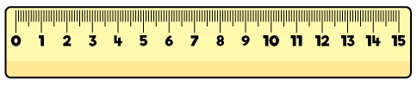
Mo has used the ruler to measure the length of the car.
Mo says the car is 8 centimetres long.
Do you agree?
Explain your answer.

Slide 4
Usain Bolt can run 100 m in 9.58 seconds (just under 10 seconds).
How far do you think you can run in 10 seconds?
Do you think it will be more or less than 100 m?
Measure how far you and your friends can run in 10 seconds.
Record your answers in metres and centimetres.

Slide 5




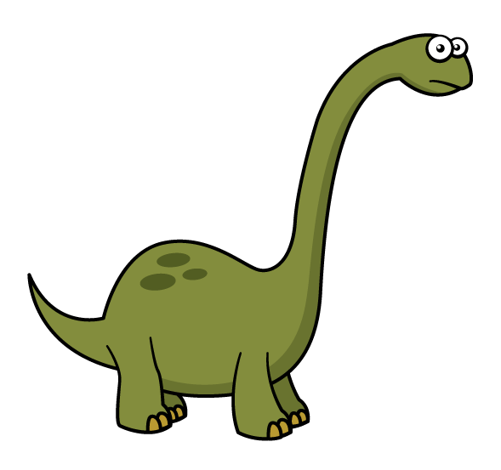




Circle the objects that you would measure in metres. Tick the objects that you would measure in centimetres.

Slide 6

Amir has a metre stick.
He wants to measure the length of his classroom.
Explain to Amir how he could measure the length of his classroom.
I can’t measure the length of the classroom because my meter stick isn’t long enough.

Slide 7
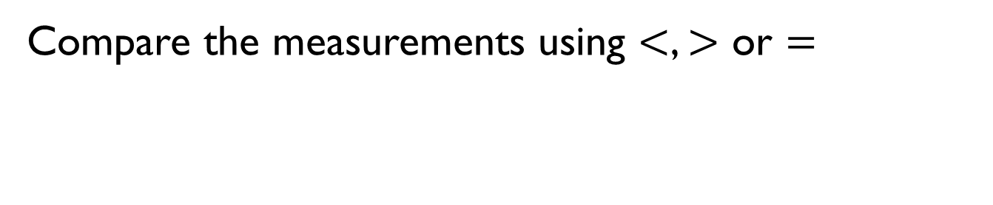



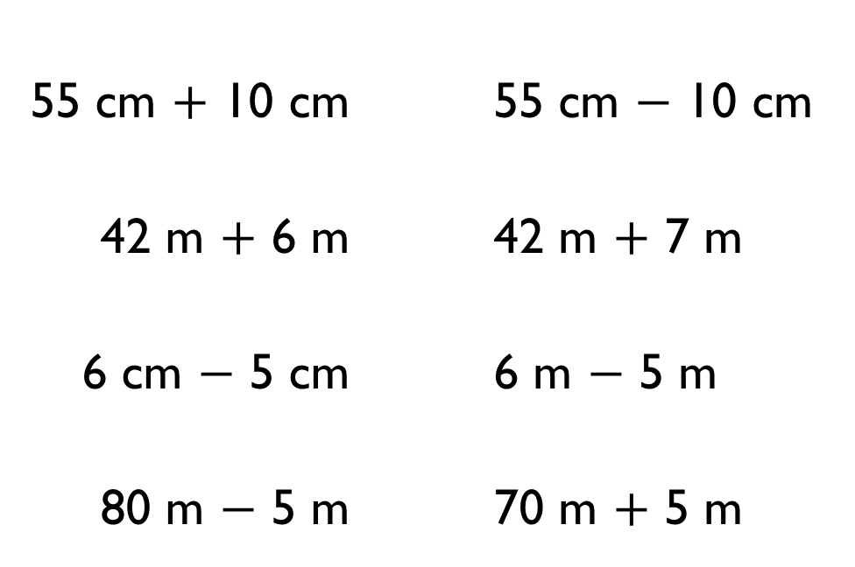
Compare the measurements using $<$, $>$ or $=$
$$<$$
$$>$$
$$=$$
55 cm $+$ 10 cm |  | 55 cm $−$ 10 cm
42 m $+$ 6 m |  | 42 m $+$ 7 m
6 cm $−$ 5 cm |  | 6 m $−$ 5 m
80 m $−$ 5 m |  | 70 m $+$ 5 m

Slide 8


A green pencil is twice as long as a blue pencil.
Using this, complete the statements using longer than, shorter than or equal to.
3 green pencils are _______ 2 blue pencils
2 green pencils are _______ 5 blue pencils
4 green pencils are _______ 8 blue pencils

Slide 9
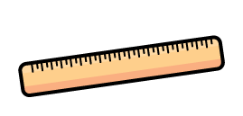
Four children are measuring their heights.
Eva is taller than Rosie, but not as tall as Mo.
Dexter is taller than Mo.
Write down their names in order of their heights, starting with the shortest.

Slide 10

Dora says,
Measure the height of people in your class and measure the length of their shoes.
Is Dora correct?
The taller you are, the longer your shoes are.

Slide 11
Here is a strip of orange paper.
A blue strip is four times longer than a orange strip.
The strips are joined end to end.
How long is the orange strip?
How long is the blue strip?
50 cm

Slide 12
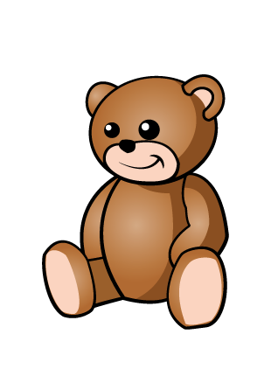
There are 3 teddies in a box.
The brown teddy is 15 cm taller than the yellow teddy.
The yellow teddy is 3 cm shorter than the pink teddy.
The pink teddy is 42 cm tall.
How tall are the brown and yellow teddies?
How much taller is the brown teddy than the pink teddy?

