Slide 1

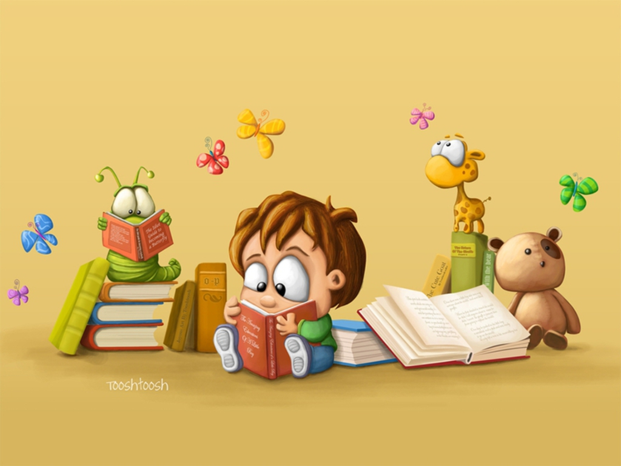
Reading for Pleasure

Slide 2
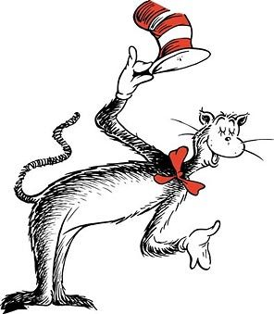

‘The more that you read, the more things you will know. The more that you learn, the more places you’ll go.’
Dr Seuss

Slide 3
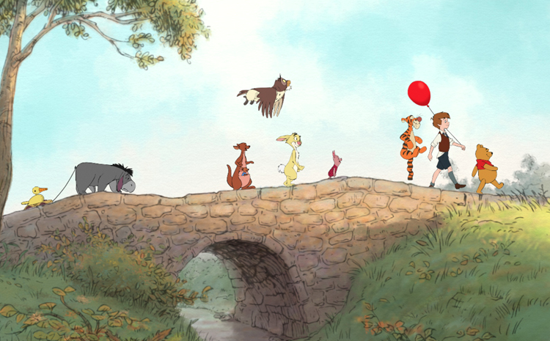
Whilst we’re staying safe at home, books can take us on journeys to different places with different characters.

Slide 4

Practising reading is important – the more you read, the better you will be.

Slide 5
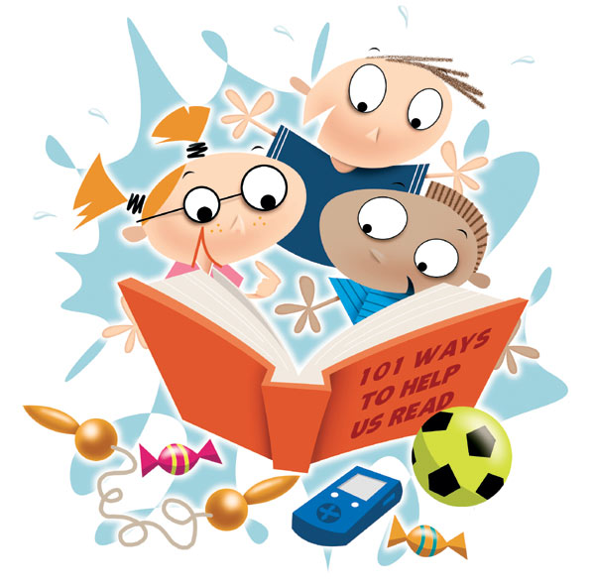
Reading for pleasure is even more important. Find some time to get lost in a book whilst you’re staying safe at home.

Slide 6

Things to remember:
1. It is fine to read the same book over and over again. If you’ve got a favourite book at home, keep reading it!

Slide 7
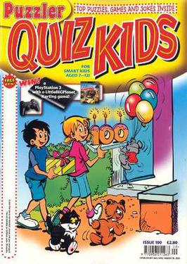

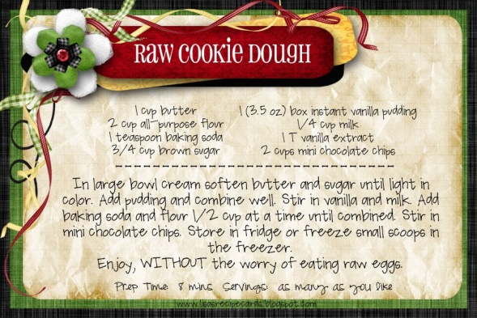
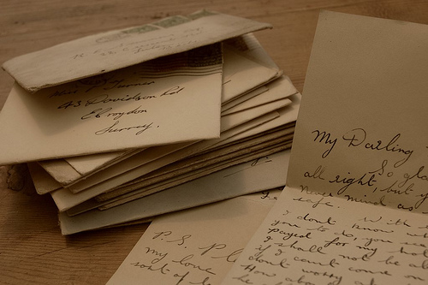

2. It doesn’t matter what you read, as long as you enjoy it! You could be reading: comics, magazines, websites, recipes, letters, instructions etc.

Slide 8
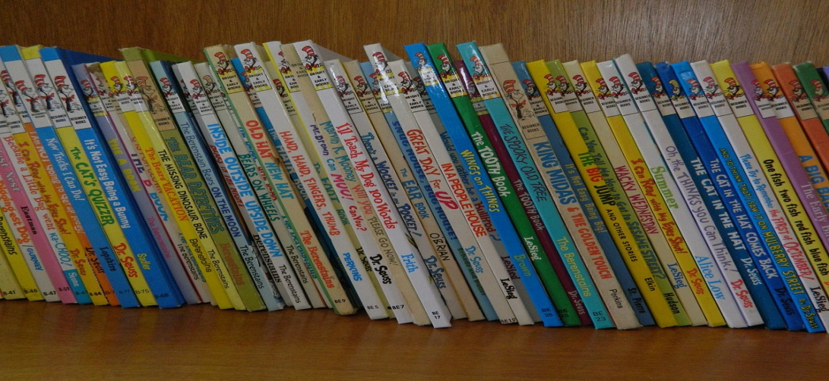
3. There will be a book out there that you’ll enjoy, so keep looking! If you’re a member of Leicester Libraries you can still access their e-books, e-comics and e-magazines.

Slide 9


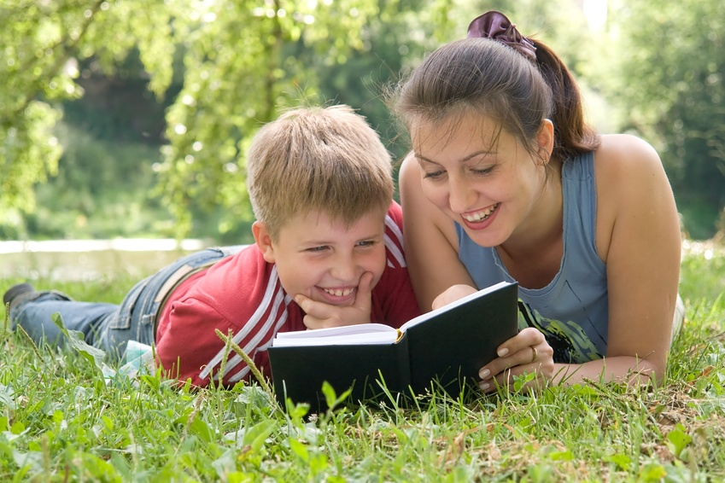
4. If children are still learning to read, make sure they don’t try to read anything that is too difficult. Foster their love of stories by reading to them and listening to books together.

Slide 10

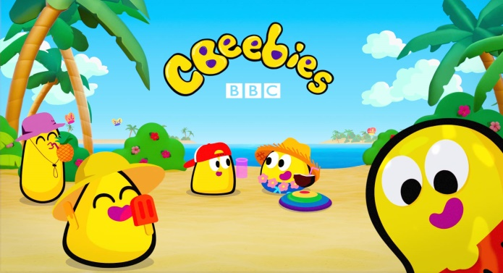

5. Make books and stories part of your daily routine!
Find a time in the day that works for you and have a story time. There are many resources you can use.
Cbeebies have 29 different bedtime stories available on BBC iplayer.
You can find more on YouTube…

Slide 11
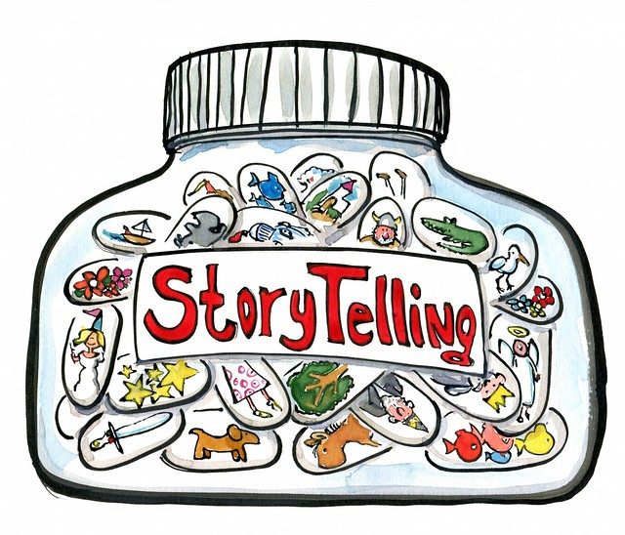

6. Tell stories: if you’re running short of books, retell the stories you know or make up your own! Tell stories from your family and make up stories about your time in lockdown.

Slide 12
More online resources that may be useful:
www.booktrust.org.uk Look particularly in the Book Trust Home Time part of the website, where you will find books to read along with as well as other activities.
www.storyberries.com More stories being read that you can read along with.
www.audible.co.uk You can sign up for a free 30 day trial and listen to lots of stories and books together.

Slide 13
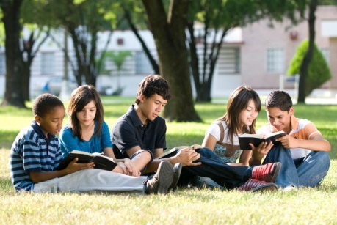
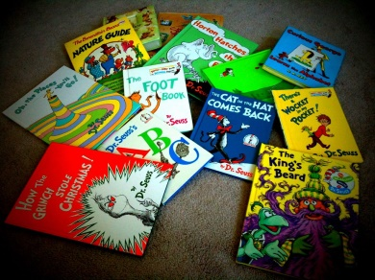

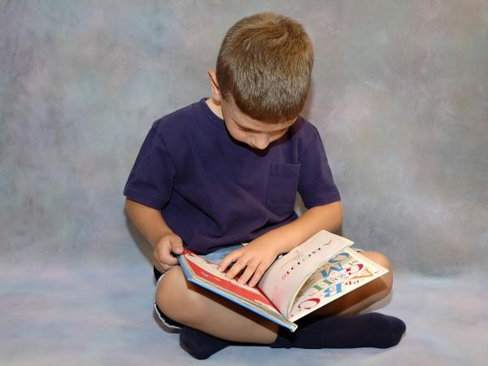
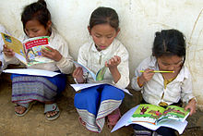
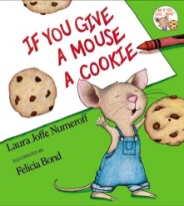
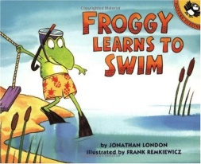
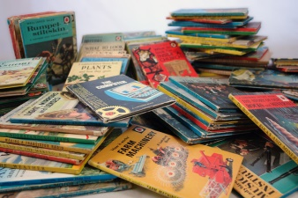
‘Reading should not be presented to children as a chore or a duty. It should be offered as a gift.’
Kate DiCamillo

Slide 14

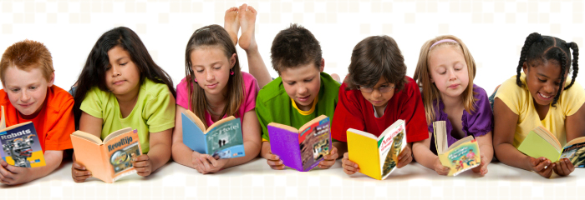

Happy Reading!

